Slide 1


Leading Together:
Governance & Advocacy
January 2026
Notes:
Introductions
Why We’re Here
Board renewal following AGM
Mix of new and returning Directors
Opportunity to align on roles, governance, and advocacy
Welcome and thank Directors for their time and service.
Acknowledge mix of new and returning Directors following the AGM.
Frame the session as practical and applied, not theoretical.
Clarify what this session is and is not:
Is: about governance, oversight, judgment, and collective responsibility.
Is not: about operational detail or partisan debate.
Walk through agenda and learning objectives.
Emphasize that questions and discussion are encouraged.

Slide 2
Objectives
Clarify Board roles and responsibilities
Strengthen governance practices
Understand NSFM advocacy with the Province
Support effective, non-partisan leadership

Slide 3
Agenda
Welcome and session objectives
Governance best practices
Roles and responsibilities of Directors
Asking effective governance questions
NSFM’s non-partisan role and ethical expectations
How NSFM conducts advocacy with the Province
Key takeaways and next steps
Notes:
Why We’re Here
Board renewal following AGM
Mix of new and returning Directors
Opportunity to align on roles, governance, and advocacy
How We’ll Work Today
Interactive discussion
Real examples
Questions encouraged
Governance focus (not operations)

Slide 4
Governance
Best Practices
Establish a shared understanding of what good governance looks like in practice and where the Board adds value.

Slide 5

What do we mean by good governance?
Notes:
Define governance in plain terms: setting direction, exercising oversight, and safeguarding the organization’s purpose.

Slide 6
What effective boards do well
Stay focused on purpose and mandate
Separate governance from management
Prepare and ask good questions
Debate respectfully and decide collectively
Speak with one voice
Support and hold the CEO accountable

Slide 7
Common governance pitfalls
Representing individual interests, not the collective
Micromanaging staff or operations
Blurring advocacy with partisan politics
Jumping to solutions instead of asking questions
Speaking publicly without alignment
Revisiting settled decisions

Slide 8
Governance vs. Management
Board (Governance) | CEO & Staff (Management)
Sets direction and priorities | Executes approved plans
Determines advocacy positions | Develops and carries out advocacy work
Provides oversight and accountability | Manages operations and resources
Approves budgets and monitors finances | Prepares budgets and manages spending
Hires and evaluates the CEO | Leads staff and day-to-day work
Speaks with one voice for NSFM | Supports and implements Board messaging
Notes:
Governance (Board): strategy, policy, risk, accountability
Management (CEO & staff): execution and operations

Slide 9
Fiduciary Duties
Responsibility | What It Means in Practice at NSFM
Act with care and diligence | Come prepared, ask informed questions, and understand the implications of Board decisions
Act in NSFM’s best interests | Put the interests of NSFM and its members ahead of individual municipal or personal interests
Act within NSFM’s mandate | Follow bylaws, policies, and the non-partisan role of the organization
Notes:
Fiduciary duties:
Duty of care (informed decision-making)
Duty of loyalty (best interests of NSFM, not individual municipalities)
Duty of obedience (acting within mandate and bylaws)

Slide 10
A Director contacts NSFM staff directly after a Board meeting to suggest changes to how an advocacy file is being handled.
Notes:
Good practice
Board input flows through the Board table and the CEO, not directly to staff.
The Board focuses on outcomes and expectations, not tactics.
The CEO manages staff and execution, consistent with Board direction.

Slide 11
Roles & Responsibilities
of Directors
Clarify expectations of
Directors individually and collectively

Slide 12

What is expected of a Director?
Collective vs. individual roles
Board–CEO relationship
Notes:
Speaking Notes / Key Points
Role of a Director:
Act in the interests of NSFM as a whole
Prepare for meetings
Participate constructively
Respect collective decisions once made
Collective responsibility:
Decisions belong to the Board, not individual members.
Relationship with the CEO:
One employee model
Oversight through goals, evaluation, and support
Committee work as a way to deepen oversight, not bypass the Board.

Slide 13
Asking Great Governance Questions
Practical tools to add value without crossing into management.

Slide 14
From Statements to Questions: How the Board Adds Value
Purpose: What problem are we trying to solve on behalf of member municipalities?
Mandate fit: How does this align with NSFM’s mandate and non-partisan role?
Collective value: Is this an issue of broad municipal interest, or a localized concern?
Assumptions: What assumptions are we making, and what would change our view?
Risk: What risks (reputational, financial, or relational) should the Board be aware of?
Options: What alternatives were considered, and why is this the recommended approach?
Implications: What happens if we do nothing or delay a decision?
Success: How will we know if this approach is working?
Notes:
Speaking Notes / Key Points
Boards add value through questions, not answers.
Good questions:
Clarify purpose
Surface risk
Test assumptions
Examples:
“What problem are we trying to solve?”
“What are the implications if we do nothing?”
“What risks should the Board be aware of?”

Slide 15


Slide 16
Role & Conduct
NSFM’s non-partisan mandate and the importance of process, discipline and consistency.

Slide 17
A Credible Voice for Municipalities
NSFM represents municipalities collectively, not individual interests
Advocacy is non-partisan and evidence-based
Credibility depends on consistency, discipline, and trust
The Board safeguards NSFM’s reputation and relationships
Notes:
Speaking Notes / Key Points
NSFM’s credibility depends on being:
Non-partisan
Evidence-based
Collective
Difference between:
Advocacy for municipal interests
Partisan political activity
Code of Conduct and spokesperson expectations:
Who speaks for NSFM
When individual views must be clearly distinguished
Risks of mixed messages—to credibility and influence.

Slide 18
A Director is asked by local media to comment on a provincial announcement that affects municipalities. The issue has been discussed at the Board table, but NSFM has not yet finalized its position or messaging.
Notes:
Good practice
Directors do not speak publicly on behalf of NSFM unless authorized.
The Director should refer the inquiry to the CEO or designated spokesperson.
Public statements wait until the Board’s position is clear and agreed.
NSFM’s credibility with the Province depends on clarity about who represents the organization.
In practice, this means:
The President/Chair and CEO are the primary public voices.
Other Directors may speak only when delegated or clearly authorized.
This is not about limiting voices; it is about ensuring government and stakeholders hear one consistent message.

Slide 19
When individual views must be clear
Directors may express personal or municipal views
Those views must be clearly distinguished from NSFM positions
NSFM positions are based on Board-approved direction
Notes:
Speaking notes
Directors wear multiple hats: municipal leader, community representative, NSFM Director.
When speaking publicly or to government:
It must be clear which role you are speaking in.
Personal or municipal advocacy should not be framed as NSFM’s position.
This distinction protects:
NSFM’s relationships with the Province
Fairness among member municipalities
The integrity of NSFM’s advocacy process

Slide 20
Understanding NSFM Advocacy
The Board’s role is to safeguard discipline, credibility, and collective focus in NSFM’s advocacy.

Slide 21
Following the Advocacy Process Matters
Advocacy issues are advanced through NSFM, not around it
The Province expects a single, coordinated channel
Side conversations or parallel advocacy weaken credibility
Process protects relationships and strengthens outcomes
Notes:
The Minister of Municipal Affairs has been clear: process matters.
When municipalities or Directors bypass NSFM, it creates confusion and undermines trust.
Following process is not about control; it ensures:
clarity of message
fairness among members
sustained access to decision-makers
Board members play a key role in reinforcing—not undermining—this discipline.

Slide 22
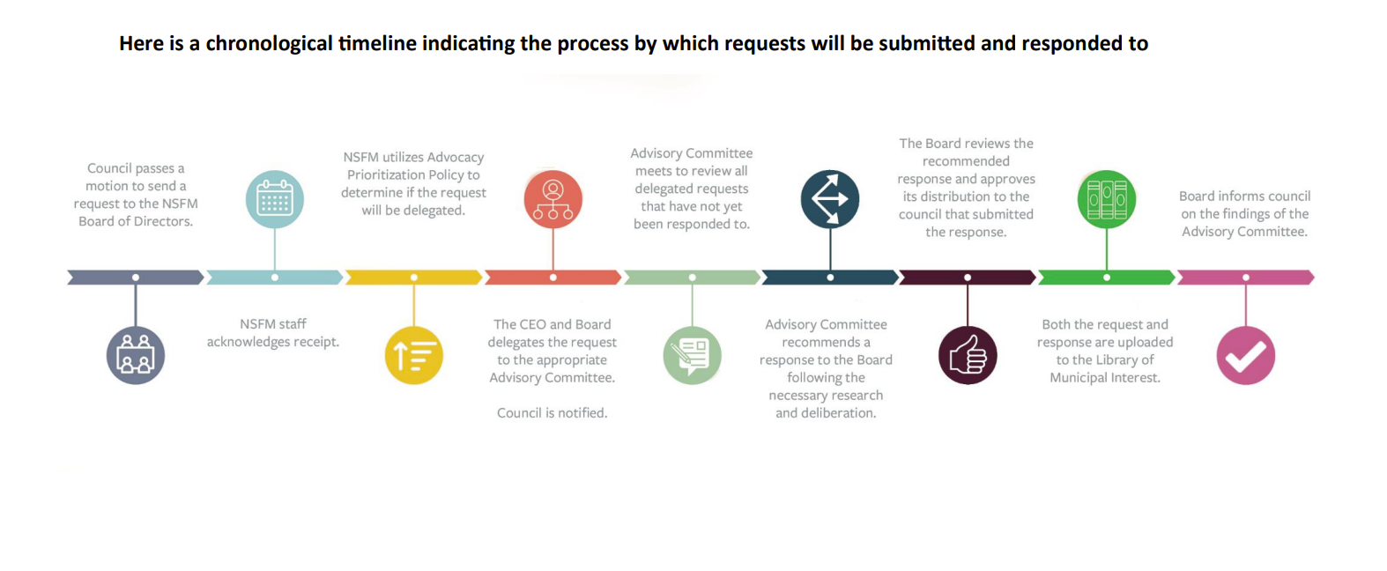
From Member Issues to NSFM Advocacy Priorities
Advisory Committees conduct analysis; the Board confirms priorities and direction.
Notes:
Key message:
The Board governs the process; it does not bypass it.
Issues are received → screened for fit → analyzed by Advisory Committees → judged and directed by the Board → advanced through a single, coordinated channel.
High-level process
Issue raised by a member municipality or identified by staff
Board or CEO decides whether to delegate
Advisory Committee reviews using the Advocacy Prioritization Framework
Advisory Committee recommends one of three responses:
Become / integrate into an advocacy priority
Monitor, but do not prioritize
Not a viable NSFM priority
Board reviews and approves the response
NSFM acts through a single, coordinated channel
What this means for Directors
Advisory Committees do the analysis
The Board provides judgment and final direction
Individual advocacy outside this process weakens NSFM’s position

Slide 23
NSFM advocacy is selective, collective,
and non-partisan by design.
NSFM advocates only on issues of general municipal concern
Not every member issue becomes an NSFM priority
Screening protects:
  Non-partisanship
  Member cohesion
  Credibility with the Province
Choosing not to advocate is often the right governance decision
Notes:
General municipal interest – any special cases where the issue is controversial and NSFM has decided to act? Policy reference appropriate notice and consultation with all interested municipal units.
Screening – staff and advisory committees

Slide 24
Where the Board adds value
Initial screening and analysis are conducted by staff and Advisory Committees, with Board oversight and direction where needed.
The Board focuses on judgment, not analysis.
Directors test whether:
  The issue reflects a clear collective municipal interest
  The issue fits NSFM’s mandate and non-partisan role
  Engagement will build or deplete political capital
  The timing and capacity are right, given other priorities
  The likely outcome justifies the level of effort

Slide 25
The Board confirms:
  Whether the issue should be advanced as an NSFM priority
  The appropriate level of engagement
No engagement: Monitor only
Low: Inform members
Medium: Develop and advance a position
High: Lead a full advocacy strategy
Notes:
Governance decision
Monitor — Track and reassess if circumstances change
Inform — Share information with members; enable individual action
Contribute — Develop a position and targeted advocacy
Lead — Execute a full, coordinated advocacy strategy

Slide 26
Where do we struggle most to stay disciplined in the advocacy process?
What makes it hardest for us to say “not now” to an issue that matters locally?
What question should we ask more consistently before supporting NSFM advocacy?
Notes:
Discussion
What happens to NSFM’s credibility if individual municipalities or Directors take issues directly to the Minister outside this process?

Slide 27
Reflection & Wrap Up

Slide 28
Where am I most at risk of confusing my municipal role with my role as a Director of NSFM?
What question should I ask more consistently at the Board table to test whether an issue truly meets NSFM’s advocacy criteria?
What is one behaviour I will change to better support disciplined, collective advocacy, even when an issue matters deeply to my municipality?

Slide 29
Key Takeaways
The Board governs through judgment, oversight, and collective decision-making.
Directors act in the best interest of NSFM as a whole, not individual municipalities.
Effective advocacy depends on a clear process and disciplined, non-partisan engagement.
Strong Boards add value by asking the right questions, not managing operations.
Consistent messaging and respect for roles protect NSFM’s credibility and influence.
Notes:
Speaking Notes / Key Points
Revisit learning objectives and confirm they were addressed.
Emphasize:
Governance is a discipline
Advocacy is a team effort
Consistency matters

Slide 30
Thank you!
Kristan Hines
khines@national.ca

