Slide 1
NSFM Q4 2025 Communications
Report
January 16, 2026

Slide 2
EXECUTIVE SUMMARY

Slide 3
EXECUTIVE SUMMARY
The fourth quarter featured a range of member engagements and strategic initiatives across NSFM’s communications platforms.
Highlights include:
Lunch & Learn Series: Three sessions were delivered – Nova Scotia Power: Renewable Energy and Nova Scotia's Path to 2030 (Oct. 8); Harassment in the Workplace Regulations – The Safety Branch of Nova Scotia Labour, Skills and Immigration (Oct. 22); and Nova Scotia's Air: What We Do and Why It Is Important – Department of Environment and Climate Change (Nov. 19).
Board Engagement: A survey on the NSFM Board experience and feedback was circulated.
Board of Directors Election Campaign: Continued through Oct. 31, with all positions successfully filled.
Fall Conference Communications Campaign: Ran leading up to and during the conference held Nov. 4–7 in Halifax.
Publications: The Municipal Observer Magazine Winter Edition was released on Oct. 8.
Funding Portal Launch: The new NSFM Funding Portal (nsfunding.ca) went live on Nov. 12.
Staffing Updates: Two positions were filled – Director of Advocacy & Policy and CCBF Program Coordinator.
This report provides an in-depth analysis of NSFM communications performance, including social media, website, media coverage, and the Monday Memo eNewsletter.

Slide 4
SOCIAL CHANNELS

Slide 5
Social Media Definitions
Commonly used terms in Social Media Content Analysis:
Clicks: refer to the total number of times users clicked on any clickable element in your content. This includes not just links but also buttons, images, or other interactive features within the post. It gives a broader view of how often people are interacting with your content beyond just link clicks.
Reactions: The responses users give to a post, such as likes, loves, laughs, or other emoji reactions. This metric shows how people feel about the content.
Engagement Rate: The percentage of people who interact with your content (e.g., likes, comments, shares, clicks) compared to the total number of people who saw it. It measures how engaging or effective your content is.
Link Clicks: The number of times users clicked on a link in your post or content, leading them to another webpage or destination.
Reach: The total number of unique users who have seen your content at least once. It reflects how many different people your content is reaching.
Content Interactions: Any action users take on a post or piece of content, such as liking, commenting, sharing, or clicking. This measures overall activity or interaction with the content.
Impressions: The total number of times your content was displayed or shown on a screen, regardless of whether it was clicked or interacted with. This counts repeat views by the same person.

Slide 6
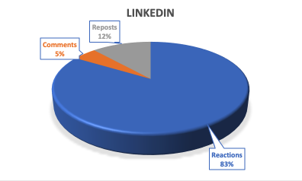

linkedin
Follower Growth – 6.09%
Oct. 1 – 1464
Dec. 31 – 1559
Engagement Rate = 10.96%

Slide 7
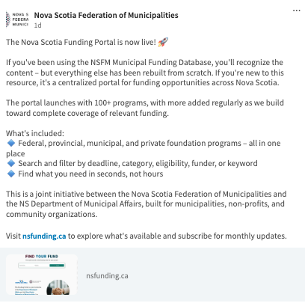


Top Performing Content
Clicks 86
Clicks 57
Clicks 57

Slide 8
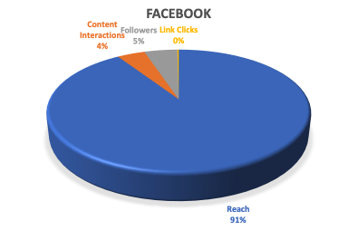
FACEBOOK
Follower Growth 6.84%
Oct. 1 – 817
Dec. 31 – 877
Engagement Rate = 4.74%

Slide 9



Top Performing Content
Views 14,082
Views 745
Views 573

Slide 10
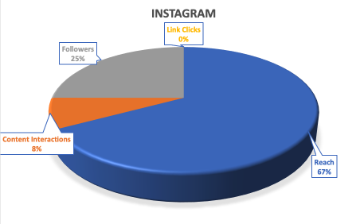

Instagram
Follower Growth 2.66%
Oct. 1 – 329
Dec. 31 – 338
Engagement Rate = 11.77%

Slide 11



Top Performing Content
Views 446
Views 364
Views 190

Slide 12
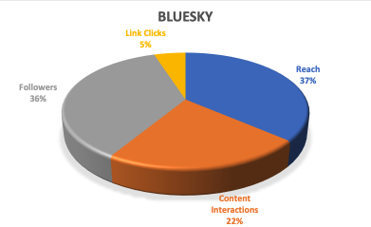

BLUESKY
Follower Growth 13.64%
Oct. 1 – 38
Dec. 31 – 44
Engagement Rate = 75%

Slide 13

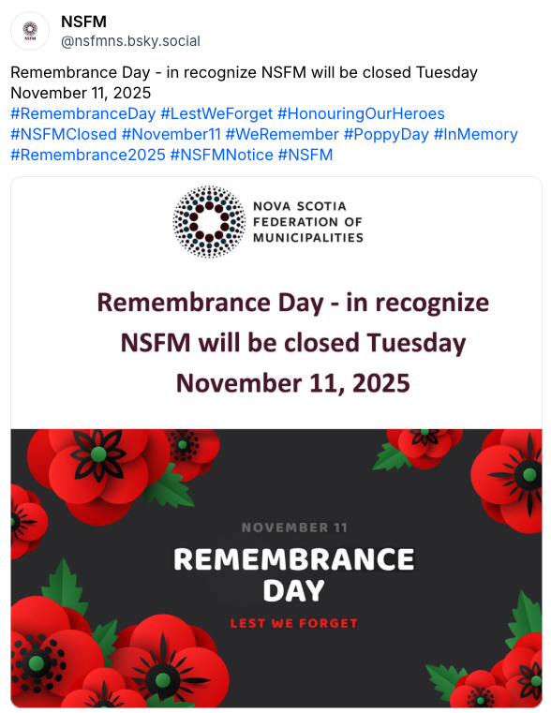

Top Performing Content
Likes 11
Likes 2
Likes 1

Slide 14
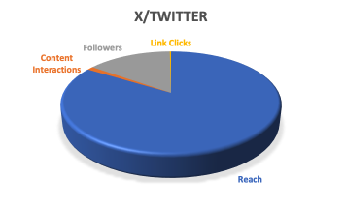

x/twitter
Follower Growth 0.186%
Oct. 1 – 1072
Dec. 31 – 1074
Engagement Rate = 1.59%

Slide 15

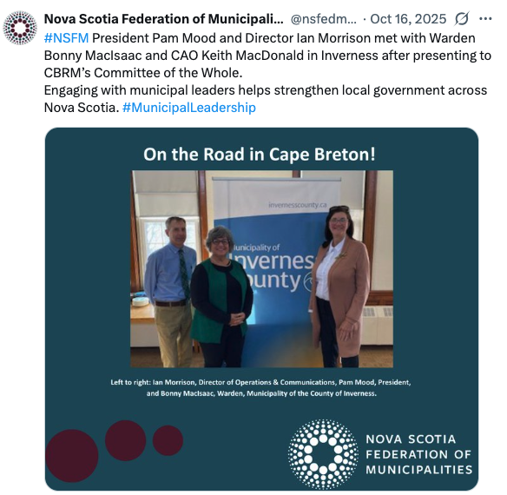

Top Performing Content
Views 236
Views 213
Views 202

Slide 16





Key Insights for Social Media
X/Twitter – supports visibility, but engagement is modest. This suggests the platform functions best for timely updates, amplification of key messages, and media-facing visibility, rather than deeper engagement.
Instagram – engagement is healthy, but conversion is limited. This platform is better suited for awareness and storytelling rather than driving traffic.
Facebook – remains NSFM’s primary reach and engagement driver. Most effective platform for broad awareness and member engagement.
LinkedIn - delivers strong professional engagement. A key channel for leadership messaging, advocacy, sector insights, and shareable thought leadership.
Bluesky – shows promise as a high-engagement niche channel. This suggests early adopters are highly engaged, making BlueSky a channel to monitor and selectively nurture as it evolves.
Notes:
Overall takeaway
NSFM’s strongest return remains on Facebook and LinkedIn, with Instagram supporting brand presence and storytelling, X/Twitter serving as a visibility and amplification tool, and BlueSky emerging as a potential high-engagement niche platform.

Slide 17
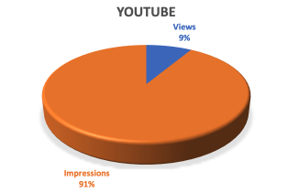

youtube

Slide 18



Top Performing Content
Views 9
Views 9
Views 7

Slide 19
NSFM Website

Slide 20
Online Definitions
Commonly used terms in Online Content Analysis:
Organic Search: Visitors who land on your website or content through unpaid search engine results, such as Google or Bing, without any paid ads.
Direct: Traffic that comes to your website directly, either by typing your URL into a browser or clicking on a saved bookmark.
Referral: Traffic that comes to your website from another site via a link, excluding social media or search engines.
Organic Social: Traffic or visitors that come to your website from unpaid, non-boosted posts on social media platforms (e.g., from regular posts, not ads).

Slide 21
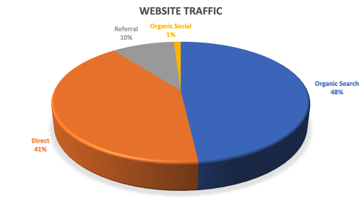



Website traffic

Slide 22


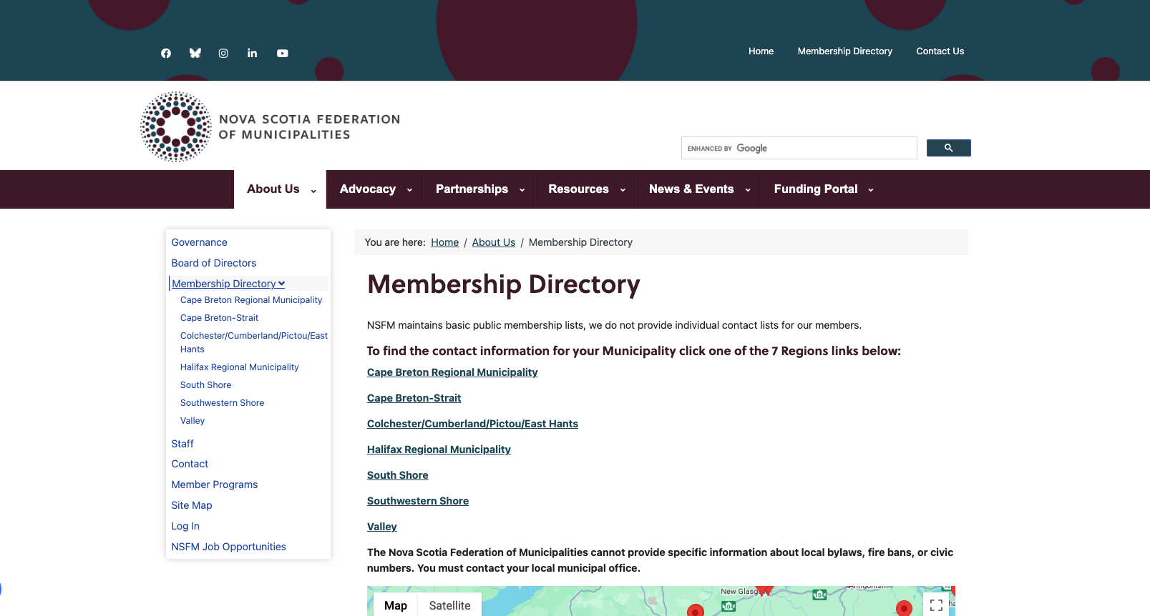
Top page performance
Page Views 4293
Page Views 1002
Page Views 1277

Slide 23
Key insights for Website
Strong Overall Traffic
Direct traffic reflects strong brand recognition
Engagement
Levels indicate meaningful content consumption
Content Strategy
Performing effectively as a trusted, search-friendly and member-driven platform.

Slide 24
SURVEY RESULTS
📊 Survey Participation Overview
INITIATIVE | COMPLETED | TOTAL | % COMPLETE | STATUS
NSFM Board Experience and Feedback | 13 | 17 | 76% | ✅ Completed

Slide 25
MEDIA

Slide 26
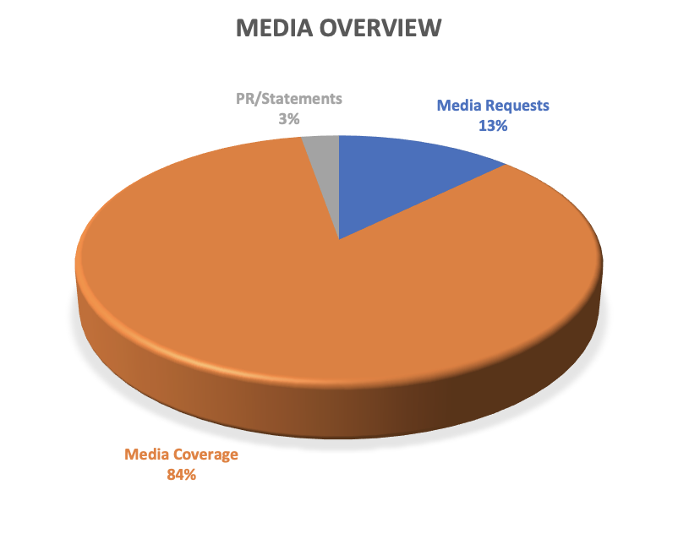
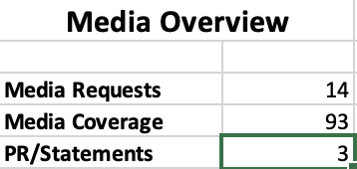
Media Overview
Notes:
MEDIA REQUESTS
Oct. 2 Todd Veinotte Show - Request for an Interview Mayor Pam Mood regarding the Trans Corridor Discussion
Response N/A
Oct. 16 Bill MacCuish of Coast Radio - Request for an Interview Mayor Pam Mood regarding the Trans Corridor Discussion
Response
Oct. 23 Ella MacDonald, Digital Broadcast Journalist, Global News RE: Premier’s signing of a MOU with Ontario to produce small modular reactors. Response N/C
Oct. 28 CTV Haeley DiRisio - RE: Press Release: Municipal Leaders Face Increased Amounts of Hostility
Response Oct. 28 ‘Unacceptable behaviour’: N.S. politicians say they face increasing threats, harassment
Oct. 28 AllNS Colin Chisholm - RE: Press Release: Municipal Leaders Face Increased Amounts of Hostility
Response Oct. 29 When Someone Threatened to Burn The Mayor's House Down
Oct. 28 CBCListen Maritime Noon with Bob Murphy - RE: Press Release: Municipal Leaders Face Increased Amounts of Hostility
Response Oct. 28 Radio Interview with mayor David Mitchell
Nov. 4 Jen Taplin @ Herald
Response Nov. 7 Airbnb, rental operators challenge restrictions in Nova Scotia, minister says measures are working, Airbnb pitches success stories to Nova Scotia municipal leaders
Nov. 4 Jesse Thomas @ CTV – Interview w Hon John A. MacDonald
Response
Nov. 4 Haley Ryan @ CBC – Interview w Hon John A. MacDonald
Response Nov. 5 N.S. municipal affairs minister promises communication on natural resource projects, Minister tells conference of municipal politicians that both sides will need to work together
Response Nov. 7 N.S. municipalities talk benefits, challenges of short-term rentals Airbnb rep says N.S system where municipalities can make own regulations is ideal model
Nov. 5 Lisa Revil @ CBC French Radio – Interview in French?
Response N/A
Nov. 5 Rebecca MacNeil, Director of Human Resources & Corporate Communications @ Town of New Glasgow
Response N/A
Nov. 6 Colin Chisholm @ AllNS.com – Interview w Pam Mood & David Mitchell
Response - Nov. 7 Municipal Leaders Exhale as Federal Budget Fears Ease
Nov. 7 Mitchell Bailey @ Global News
Response Nov. 7 Nova Scotia Power CEO has fireside chat with municipalities
Nov. 25 Brian Flinn @ AllNovaScotia.com - RE: DMA Minister Letter about municipal financing
Response N/C
MEDIA COVERAGE follows

Slide 27



TELEVISION
17 Stories
210,000 viewers from
NS, NB & PEI
5 Stories
1 Storie
Notes:
TELEVISION
CBC News
Oct. 16 Nova Scotia removes public’s ability to file complaints about municipal politicians
Oct. 20 Portraits of more than 140 veterans line Springhill streets
Nov. 20 How tourism boom has changed Inverness over the years
Nov. 21 Concerns over Joggins fire department discussed at public meeting
Nov. 25 Truro community centre CEO 'deeply disappointed' by county decision
CTV News Atlantic
Oct. 8 Mandatory water restrictions implemented for East Hants, N.S.
Oct. 12 Dartmouth residents give their input on future of local park
Oct. 24 Halifax mayor wants to see more roadwork at night to ease traffic gridlock despite Canada-U.S. trade conflict
Oct. 28 ‘Unacceptable behaviour’: N.S. politicians say they face increasing threats, harassment
Nov. 11 Mayors of Halifax and Boston celebrate ties despite Canada-U.S. trade conflict
Nov. 13 Nearly 200 dry wells remain in Cape Breton Regional Municipality, despite recent rainfall
Nov. 13 N.S. government quashes ‘unreasonable’ plan for West Mabou Beach golf course
Nov. 20 Nova Scotia company says it has launched its second suborbital test rocket
Nov. 21 Speed display signs only slow drivers down by 1km/h: Halifax report
Nov. 25 Recreation program planning could be improved: HRM auditor genera
Dec. 2 Halifax councillor seeking report on impact of capped assessment program
Dec. 2 N.S. needs guaranteed basic income because ‘too many people are suffering’: advocate
Dec. 9 ‘Tough decisions’: Halifax committee keeps proposed $4M skate park upgrades after debate
Dec. 15 Halifax mayor says city will do what it can to support Shannon Park development
Dec. 15 Third-party investigation launched into allegations of financial irregularities at Halifax Water
Dec. 16 Halifax Water gets approval for rate hike
Dec. 17 N.S. announces $465M for major road, highway projects as part of five-year plan
Global News
Nov. 26 Canada launches new alert system to protect people in extreme weather

Slide 28







print
30 Stories
3 Stories
2 Stories
2 Stories
1 Story
1 Story
1 Story
1 Story
Notes:
PRINT
CBC News
Oct. 1 Cenotaph in Shubenacadie, N.S., to be returned to original location
Oct. 2 Mayor says N.S. municipalities must be part of transportation corridor discussions
Oct. 7 Truro spending $628K to fill ponds created during baseball field construction
Oct. 11 Parts of Nova Scotia, New Brunswick experiencing once-in-50-year drought
Oct. 14 'Everybody's pissed': Break-in at volunteer fire department in Guysborough County causes upset
Oct. 14 N.S. government boosts loan access for municipalities by $500M
Oct. 14 N.S. municipal electric utilities say Maritime alliance brings big benefits
Oct. 18 Volunteer fire department shut down by Cumberland County after alleged misconduct
Oct. 27 Mulgrave mayor applauds amendments to province's municipal code of conduct
Oct. 29 Operation of Truro rink 'compromised,' says county as management contract cancelled
Oct. 30 'People are furious': Deed transfer tax debate rages on in Kings County
Nov. 1 Kings County to review paperless voting after residents ask court to void 2024 election
Nov. 7 N.S. municipalities talk benefits, challenges of short-term rentals
Nov. 9 Digby councillor confronts Nova Scotia Power CEO on late payment to contractor
Nov. 12 Truro, Colchester residents weigh in on public transit maps
Nov. 13 Lunenburg keeps electrical utility, plans to double grid capacity
Nov. 14 Cabot golf properties contribute $1.2M in taxes to Inverness County
Nov. 19 Plans for Halifax-area development off Highway 102 corridor raise concerns
Nov. 21 West Hants didn't need its water contingency plan this year, but it is better prepared for future droughts
Nov. 25 N.S. libraries ask users to contact MLAs, municipalities about impending cuts
Nov. 29 Colchester mayor promises overview of Truro community centre controversy
Nov. 29 'Can't get 'er done fast enough': Behind the push to open a new Annapolis Valley pool
Dec. 2 N.S. government has no plans to consider guaranteed basic income
Dec. 4 Halifax police board says use of force policy must prioritize de-escalation, training
Dec. 9 'Like dog poo': Historic N.S. garden gets a smelly surprise from tree
Dec. 10 West Hants council approves $20K for warming centre
Dec. 10 Fishermen concerned Ingonish sewer outfall will affect harbour livelihoods
Dec. 10 Halifax mayor did not break code of conduct with CAO comments, investigator found
Dec. 17 Richmond County resident says spending records reveal questionable expenses
Dec. 31 Councillor says cops should be called if Dartmouth Cove development work begins
The Chronicle Herald
Oct. 1 Evacuation area expanded again as Lake George wildfire doubles in size
Dec. 11 Opinion: Cybercriminals helpfully exposed Nova Scotia Power’s weaknesses
Cape Breton Post
Oct. 15 CBRM councillor Paul Nickituk takes medical leave of absence following cancer diagnosis
Oct. 24 Struggles, signs of life and identities lost: Looking back at 30 years of CBRM amalgamation
The Canadian Press
Oct. 13 Nova Scotia offers up to $3,000 to wildfire evacuees in Kings County
Annapolis Valley Register
Nov. 3 Annapolis considering waiving building fees following disasters
PressReader
Nov. 12 Short-term rental operators checking out
Nov. 14 Deed transfer tax passes final vote
Nov. 20 Drought com­mit­tee will tackle dry wells
The Laker News
Nov. 18 Province announces funding to protect first Acadian Cemetery, replica chapel from climate change
Insurance Business
Dec. 4 Canadian homeowners urged to review winter insurance coverage as storm risks rise - With severe weather increasing in intensity and frequency, risk mitigation is crucial

Slide 29




Radio
12 Stories
10 Stories
3 Stories
1 Story
Notes:
RADIO
Oct. 8 - Y95.5 - Yarmouth volunteer reception highlights those who give their time
Oct. 8 - Y95.5 - Yarmouth warden says they’re helping people through dry spell
Oct. 8 - 101.5 The Hawk - Bridges closed for months until repaired or replaced in Port Hawkesbury
Oct. 8 - 101.5 The Hawk - Fire flow testing in Port Hawkesbury
Oct. 14 - Y95.5 - Argyle wants province to add signage at wharves
Oct. 14 - 101.5 The Hawk - Additional housing is coming to Antigonish provided by federal funding
Oct. 15. - Y95.5 - Showers, laundry available on Sherose Island as drought continues
Oct. 21 - CKBW - Taking action towards climate change across Nova Scotia
Oct. 21 - 101.5 The Hawk - Time to name the Inverness Multicourt Facility
Oct. 22 - 101.5 The Hawk - Less Canadians going south leads to ‘CAT’ ferry passenger drop
Oct. 24 - 101.5 The Hawk - New Board Chair for ECRL
Oct. 29 - 101.5 The Hawk - N.S. municipality federation sounds alarm on threats, hostility toward elected officials
Oct. 31 - Y95.5 - Yarmouth launches surplus lands policy to boost affordable housing
Nov. 7 - 101.5 The Hawk - Bridgewater Mayor David Mitchell elected as new NSFM President
Nov. 13 - Y95.5 - Economic impact study on ‘CAT’ ferry expected in ‘coming months;’ Tilley
Nov. 14 - Y95.5 - Town of Yarmouth to host tree lighting November 28
Nov. 20 - 101.5 The Hawk - Inverness County wants feedback on sewer and water bylaw
Nov. 25 - Y95.5 - Development proposed for former Yarmouth tourist bureau
Nov. 25 - CKBW -New panel taps industry leaders to launch Atlantic economic growth
Nov. 25 - 101.5 The Hawk - Pictou-Antigonish libraries may cut hours, programs and services
Nov. 28 - Y95.5 - Accessibility a focus for Western Counties Regional Library
Dec. 4 - 101.5 The Hawk - Sewer and water bylaw scrapped by Inverness County
Dec. 15 - 101.5 The Hawk - Antigonish construction traffic delays affect local businesses
Dec. 16 - CKBW - Special election in Shelburne on February 21
Dec. 17 Staffing at Yarmouth Fire Department not meeting standards; union
Dec. 31 - Acadia Broadcasting - Rocky start to 2025 with big items addressed, say Halifax Councillors
CityNews 95.7
Oct. 8 Council votes in favour of restricting infilling at Dartmouth Cove

Slide 30

Online
2 Stories
Notes:
ONLINE
Government of NS
Oct. 7 Amendments Clarify Code of Conduct for Elected Officials
Oct. 27 More Nova Scotia Communities Taking Action to Become Resilient to Climate Change

Slide 31
eNewsletter

Slide 32
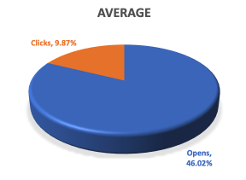

Monday Memo
Notes:
Audience/Distribution 708

Slide 33

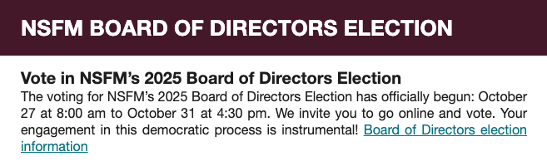

TOP performing Content
123 Clicks
118 Clicks
69 Clicks

Slide 34
Key insights for Monday memo
Average Open Rate
46.02% is well above industry benchmarks for government and association newsletters (typically 30-35%), indicating that NSFM's content remains highly relevant and trusted by members.
Average Click Rate
9.87% is a strong engagement indicator - reflecting genuine interest and value in the content provided.
Notes:
Key Insights:
Nearly half of recipients are opening the Monday Memo, indicating strong engagement with content.
Click-through rate is just under 10%, showing that while readers open the newsletter, there’s room to boost interaction with links or calls-to-action.
Consistent open rates suggest subject lines are effective; testing link placement or more compelling CTAs could improve click performance.

Slide 35
Member Quotes
Re: Oct. 7 News Release: Amendments Clarify Code of Conduct for Elected Officials
Great change! - Councillor, Town of Kentville
Thank you very much for the update and explanation. I think this was a wise move. - Mayor, Town of Kentville

Slide 36
SCCF UPDATE

Slide 37
SCCF Website UPDATE
Quarterly Overview: October – December 2025
1,951 (+57%)
Total Unique Users
Active users engaging with the SCCF
website over the three-month period
2,402
Total Sessions
Combined traffic from direct visits,
organic search, and referrals
2,947
Page Views
Cumulative views across the
most popular pages
Notes:
Key Insights
-This represents strong quarter‑over‑quarter visibility and audience reach for SCCF.
-Direct traffic was the primary driver, indicating strong brand recall and untracked shares.
-Engagement is strongest around core credibility and funding‑related content.

Slide 38
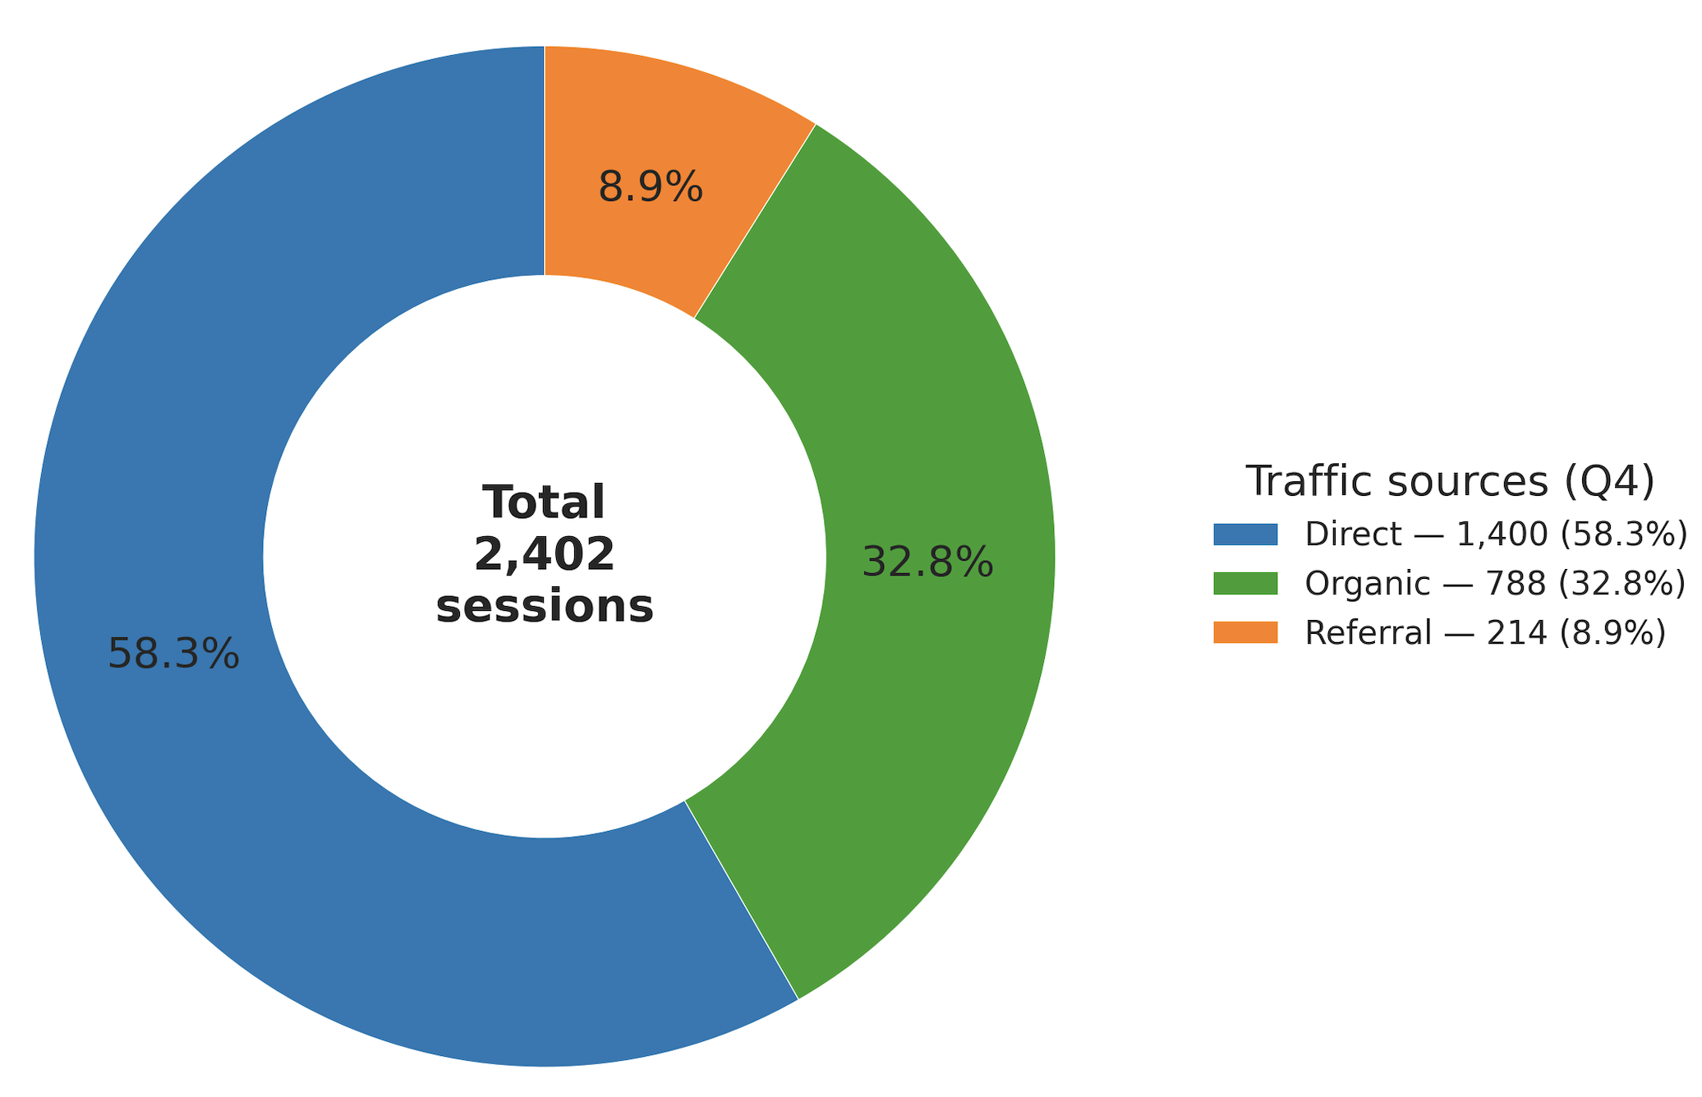
SCCF Website UPDATE
Traffic Sources Analysis
Key Insights
Direct sessions up sharply (+87%)
Likely from owned channels without UTM tagging (email/newsletters, PDFs) and dark social (untracked shares, messaging apps). Offline touchpoints (print, events) could also be contributing.
Organic search up slightly (+7%)
Helpful, but below the Direct trend—suggests SEO discoverability (and/or content freshness around grants) is the next lever.
Referral down (–19%)
Fewer media mentions or partner links, or stale/broken referrals. Quick backlink hygiene could recover this.
Engagement skew toward outcomes over instructions
Successful applicants (+31%) outpaced Funding (–13%) and How to apply (–11%). Visitors are drawn to proof and outcomes but may not be seamlessly progressing into the application path.

Slide 39
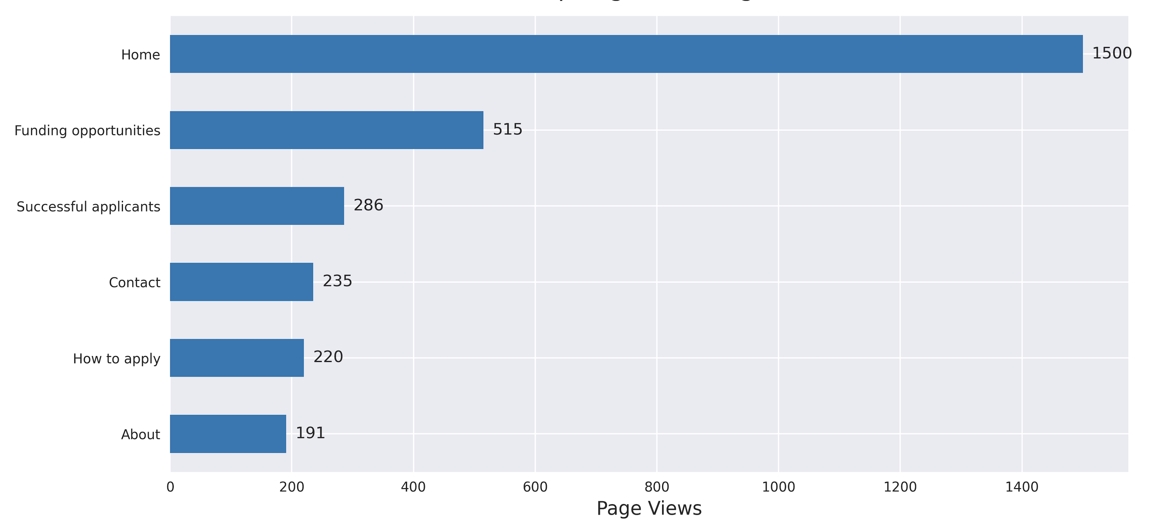
SCCF Website UPDATE
Notes:
Key Implications
Brand demand is strong (Direct). Now convert it: ensure visitors immediately see “Funding” / “Am I eligible?” prompts above the fold.
SEO is the next growth lever: +7% is fine, but given your audience, there’s room for intent‑based content around eligibility, timelines, and municipality‑specific queries.
Referral is leaving growth on the table: High‑authority partner links and media mentions can both replenish top of funnel and boost SEO via backlinks.
Outcome content is a magnet (Successful applicants). Leverage it to pull users into the application flow.

Slide 40
Project Announcements
November 17: Société historique acadienne de la Baie Sainte-Marie

