Slide 1


NSFM Board Meeting
Key EPR issues
February 6th, 2026

Slide 2

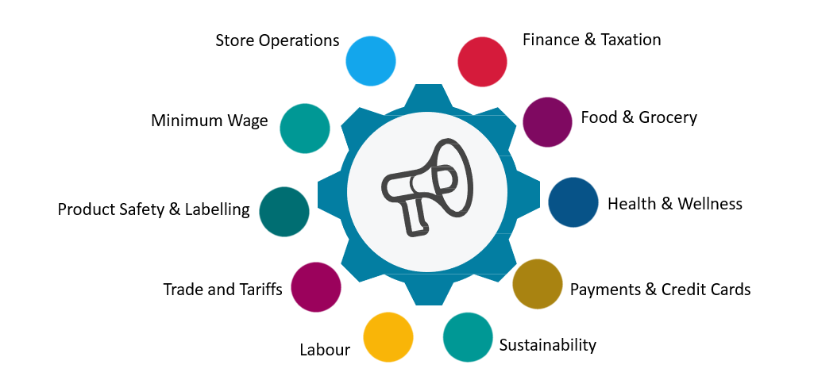
The Retail Council of Canada: The Voice of RetailTM since 1963
RCC represent provincial, national & international:
Driving advocacy, collaboration, tools and resources in 10 key areas:
groceries
pharmacies
department stores
fashion retailers
online retailers
quick service restaurants
independents….
Representation:
  1,000+ members
  54,000+ store fronts
The strength of a national network – Vancouver, Winnipeg, Toronto, Ottawa, Montreal, Halifax

Slide 3
Sustainability Pillars at RCC
RCC Sustainability is built around 3 high impact pillars:
  Advocacy and Policy Influence
    Driving action on Extended Producer Responsibility (EPR), Plastics, Climate Action, and more at both provincial and federal levels
  Community and Convening
    Bringing stakeholders together through workshops, committees, webinars, and our annual sustainability conference
  Thought Leadership and Enablement
    Equipping members with tools, resources, and experiential learning opportunities
Advocacy and Policy Influence
Community and Convening
Thought Leadership and Enablement
These pillars enable RCC to drive policy, community alignment, and practical action for retailers and their supply chains.

Slide 4

EPR Programs Across Canada
Transitioning to EPR over the last decade, end-of-life responsibility has been placed on producers and RCC is actively:
Supporting members through national advocacy and helping them navigate growing compliance burdens across 110+ EPR programs and 150+ plastics regulations across jurisdictions.
Engaging with closely with Producer Responsibility Organizations (PROs) and participating on several EPR governance boards.
NFLD & Labrador
Beverage
Electronics
Paints
Tires
Used Oil
Yukon
Batteries
Electronics
T Hazardous Waste
T PPP
Tires
T Used Oil
NWT
Beverage
Electronics
PEI
Agriculture
Batteries
T Beverage
Electronics
Lights
Pharmaceuticals
Paint
Tires
Used Oil
New Brunswick
Beverage
T Batteries
Electronics
T Lights
Pharmaceuticals
PPP
T Tires
Used Oil
British Columbia
Batteries
Beverage
Electronics
Hazardous Waste
Large Appliances
Lights
Outdoor Power Equipment
Pharmaceuticals
Paint
PPP
Thermostats and Alarms
Tires
Used Oil
Manitoba
Agriculture
Batteries
Beverage
Electronics
Hazardous Waste
Lights
Paint
Pharmaceuticals
PPP
Thermostats
Tires
Used Oil
Quebec
Agriculture
Batteries
T Beverage
Electronics
Hazardous Waste
Large Appliances
Lights
Pharmaceuticals
Paint
PPP
Tires
Used Oil
Alberta
Batteries
Beverage
Electronics
Hazardous Waste
Paint
T PPP
Tires
Used Oil
Saskatchewan
Agriculture
Batteries
Beverage
Electronics
Hazardous Waste
Paint
PPP
Tires
Used Oil
Ontario
Batteries
Electronics
Hazardous Waste
Lights
Pharmaceuticals
Paint
T PPP
Thermostats
Tires
Used Oil
Nova Scotia
Batteries
Beverage
Electronics
Lights
Pharmaceuticals
Paint
T PPP
Tires
Used Oil
EPR Program
Stewardship Program
Transitioning or New Program
Legend
T
Although all governments are pursuing the same environmental objectives, differences in regulatory requirements across jurisdictions create unnecessary hurdles and artificial trade barriers within Canada, slowing progress toward shared goals.
Notes:
Today there are over 110 EPR and Stewardship programs in Canada covering a wide range of materials and products, often with varying regulatory requirements. As provinces and territories modernize their regulatory requirements under EPR, retailers are taking over the financial and operational responsibility of recycling the products they supply. This transition incentivizes producers to develop product and packaging designs more sustainable. As producers take over responsibility through EPR transitions, significant investment in infrastructure is needed to meet regulatory objectives.

Slide 5
EPR & Plastics Advocacy
Challenges:
Complex, fragmented federal, provincial and municipal policies and regulatory inefficiency are driving higher costs and compliance risk
Unrealistic, misaligned recycling regulations and targets are driving significant compliance and reporting pressures across the value chain
Significant new infrastructure investment is required to meet evolving regulatory objectives
Limited transparency into cost drivers and performance from PROs
RCC actions:
Driving transparency and disclosure
Seeking consolidated system models to improve efficiency and control escalating costs
Cost transparency and performance accountability across all EPR programs
Evidence-based regulations and targets
Advancing evidence-based, phased targets aligned with infrastructure and market realities
Advocating for practical plastics and chemicals policy across all levels of government
Regulatory alignment & risk reduction
Driving federal, provincial and municipal harmonization to reduce fragmented compliance, inefficiency, and risk of stranded investment
Harmonized system designs, improved cost transparency and performance accountability, and practical phased in approaches will increase system credibility, compliance integrity, and drive environmental objectives.

Slide 6
NS flexible plastics targets are not achievable
Challenges:
NS targets set too high, too fast.
No jurisdiction has exceeded ~18% on a marketed / input-to-recyclers basis (EU highest benchmark).
New Brunswick is starting at 4% (marketed tonnes) until 2027 to allow for system evaluation.
Why are flexible plastics difficult to sort and recycle?
Flexibles are thin/light, hide under heavier items, fall through screens and contaminate other streams.
Scaling toward a more reasonable target still requires phased MRF investment, upgrades stable end recycling markets.
Jurisdiction | Target (%) | Actual (approx.) | Collected | Marketed | Recovered
Nova Scotia | 30% (2026–27) → 40% (2028–29) → 50% (2030) (+5 pts / 5 yrs to 85%) | TBD (program not yet reporting) |  | ✓
New Brunswick | 4% (2026-27 – holding baseline to further assess market) | ≈4% (baseline from 2024) |  | ✓
Ontario | 10% (2026–27) → 15% (2028–31) → 25% (2032+) | TBD (recovered % not yet published), estimated ≈ 2-4% marketed |  |  | ✓
British Columbia | 50% (by 2027) | ≈20% (2024) | ✓
EU | n/a | ≈18% (Germany) |  | ✓
Definitions
• Collected: tonnes collected from households (before sorting/processing)
• Marketed: tonnes sorted/baled and shipped to recyclers/end markets (after sorting)
• Recovered: tonnes credited after processing into usable outputs (post-processing; yield loss removed)
RCC recommendation: That NS government wait to view at least 1 year of performance data and market information before setting evidence-based targets that consider other jurisdictions, including aligmment with NB.

Slide 7
Transparency and Disclosure
The importance of transparency
The drive for transparent reporting in NS
System costs and producer fees continue to rise, yet visibility into how costs are structured and allocated remains limited. Without consistent disclosure, confidence in system performance and value erodes.
Transparency is essential for:
Assessment performance against targets and outcomes
Clear identification of true cost drivers
Stronger producer and stakeholder confidence
Early identification of emerging compliance risks
Informed, evidence-based decision-making and reform
RCC is engaging key stakeholders in Nova Scotia to push transparent financial and performance reporting from PROs to better understand trends, risks and opportunities.
Key performance indicators:
Recovery & volumes: Tonnes supplied and collected, plus recovery rates and how results relate to Program Plan targets.
Financials & reserves: Audited financial statements (revenues/expenses, balance sheet/cash).
Costs: Key cost indicators (e.g., cost per tonne / per household) and narrative on the collection + post-collection system that drives those costs.
Operations & risk: Service coverage, accessibility, operational outcomes (e.g., recycling vs disposal handling).
RCC recommendation: That NS government mandate PROs to provide comprehensive annual reporting, aligning with BC requirements.
Notes:
For all the above issues that are outlined we want to collaborate
RCC can bring our members to the table (engage) and facilitate progress on all issues
In the past, RCC has collaborated with ECCC on data gathering initiatives related to actions taken by the retail industry on PFAS. RCC’s work has resulted in valuable stakeholder feedback, providing insights into the significant actions taken to-date and the realities faced by Canadian retailers of all sizes. RCC would welcome any future collaboration with ECCC to help sustainable change across the value chain.

Slide 8


THANK YOU
MERCI
t
Michael Zabaneh
Vice President,
Sustainability
mzabaneh@retailcouncil.org
THANK YOU
Jim Cormier
Director,
Atlantic Canada
jcormier@retailcouncil.org

