Slide 1
COVID-19 Response

Slide 2
Beginnings
May 6, 2003 the six municipal units with Pictou County signed an Inter-municipal Emergency Service Agreement to establish one municipal emergency management organization for Pictou County
Created REMO Pictou County and the Pictou County Regional Emergency Response Plan

Slide 3
Regional Emergency Response Plan
Provides integrated organizational structure to promote coordinated municipal emergency planning activities and to provide for an immediate, coordinated and effective response to an emergency situation.
All-Hazards Plan
Designates the immediate actions to be taken by elected municipal officials, municipal services, and volunteer agencies to mitigate the effects of a disaster.
Public safety, protection of property, & protection of the environment

Slide 4
Regional Emergency Response Plan
Continued development of contingency plans (forest fires, pandemics, major weather events, etc.)
Performs regular Hazard Identification and Risk Assessments (HIRA)

Slide 5
REMO Planning Committee
Made up of:
  REMO Coordinator and Alternate
  Senior municipal administrators (CAOs, Town Clerk, etc.)
  Police agency representatives
  Fire Department representatives
  Public Information officers
  Local industry partners
  Community groups (Aberdeen Health Foundation, Kids First, etc.)

Slide 6
REMO Planning Committee
Helps Coordinator review existing plans, develop new plans, set goals for future projects
Members could be called in to work in Emergency Coordination Centre (ECC) during an incident
Committee mandated by by-law to meet minimum 3 times per year, has met monthly for last several years
Regular meetings likely to resume soon

Slide 7
How We Respond
Calls from fire/police/EHS/other agencies to provide support
May require creation of Incident Management Team
May require activation of Emergency Coordination Centre (ECC)
Uses Incident Command System (ICS) to streamline response
Keeps EMO informed

Slide 8
Emergency Response Structure
Municipal Elected Leadership
Liaison
Planning
Operations
Logistics
Municipal Administrative Leadership
Information
Safety
Finance & Admin

Slide 9
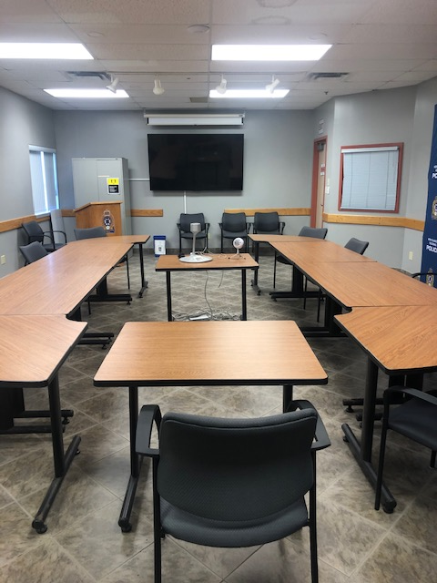
Emergency Response Structure
Emergency Coordination Centre (ECC) in New Glasgow Police Department
Alternate ECC in Municipality of the County of Pictou building

Slide 10
Recent Projects
Hurricane Dorian (partial ECC activation)
Blue Mountain Fire Department radio support (coverage issues)
Continuing care planning support (Riverview, Glen Haven)
Supply chain disruption support (train delays)
Pandemic response (virtual ECC activation)
Needle sharp washup support (Pictou Landing)
Community Links Senior’s Outreach (emergency kits)

Slide 11
Ongoing Projects
Pandemic Response
Heat Alert Response System planning
Pictou Island evacuation planning
Public communication revamp
Regular review of existing plans

Slide 12
COVID-19 Response Overview

Slide 13
Covid-19 Response
Reviewed structure of response with REMO Planning Committee, determined Lisa MacDonald and Brian Cullen (CAOs of New Glasgow and Municipality of Pictou County) would share Incident Commander roles for Incident Management Team based on legislation
Reviewed pandemic contingency plan with Incident Commanders
Met virtually to discuss possible responses when first cases appeared in Nova Scotia
Activated virtual Incident Management Team after State of Emergency declared

Slide 14
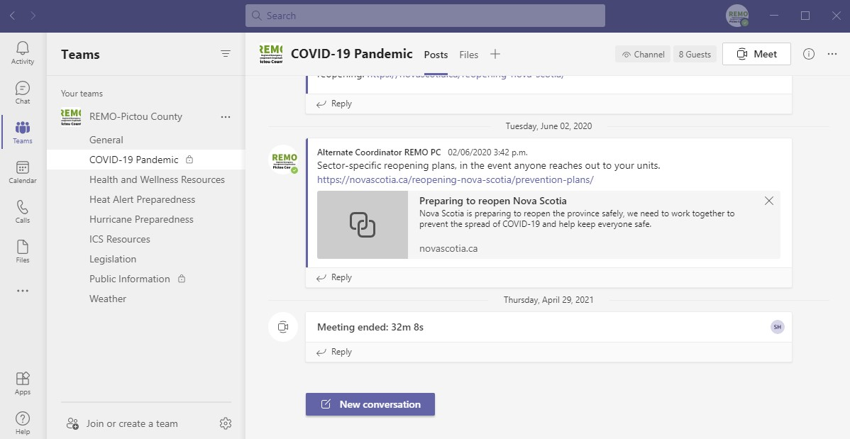
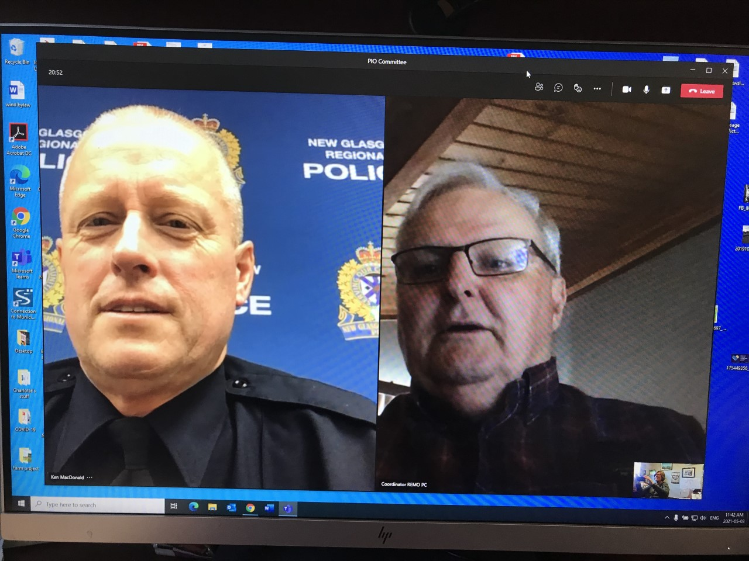
COVID-19 Response
Set up daily (later weekly, and then monthly) virtual IMT meetings
Incorporated members from each of the six municipal units

Slide 15
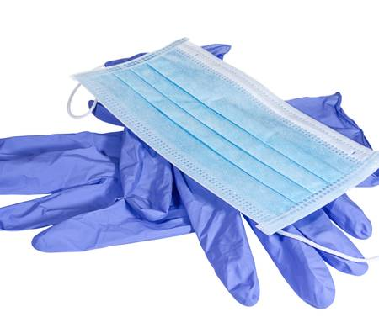
COVID-19 Response
Coordinated Personal Protective Equipment (PPE) needs for the municipal units & first responder agencies
Set up Logistics Centre at Westville Town Hall
Fire departments, police agencies, public works departments obtained initial PPE needs from this centre

Slide 16
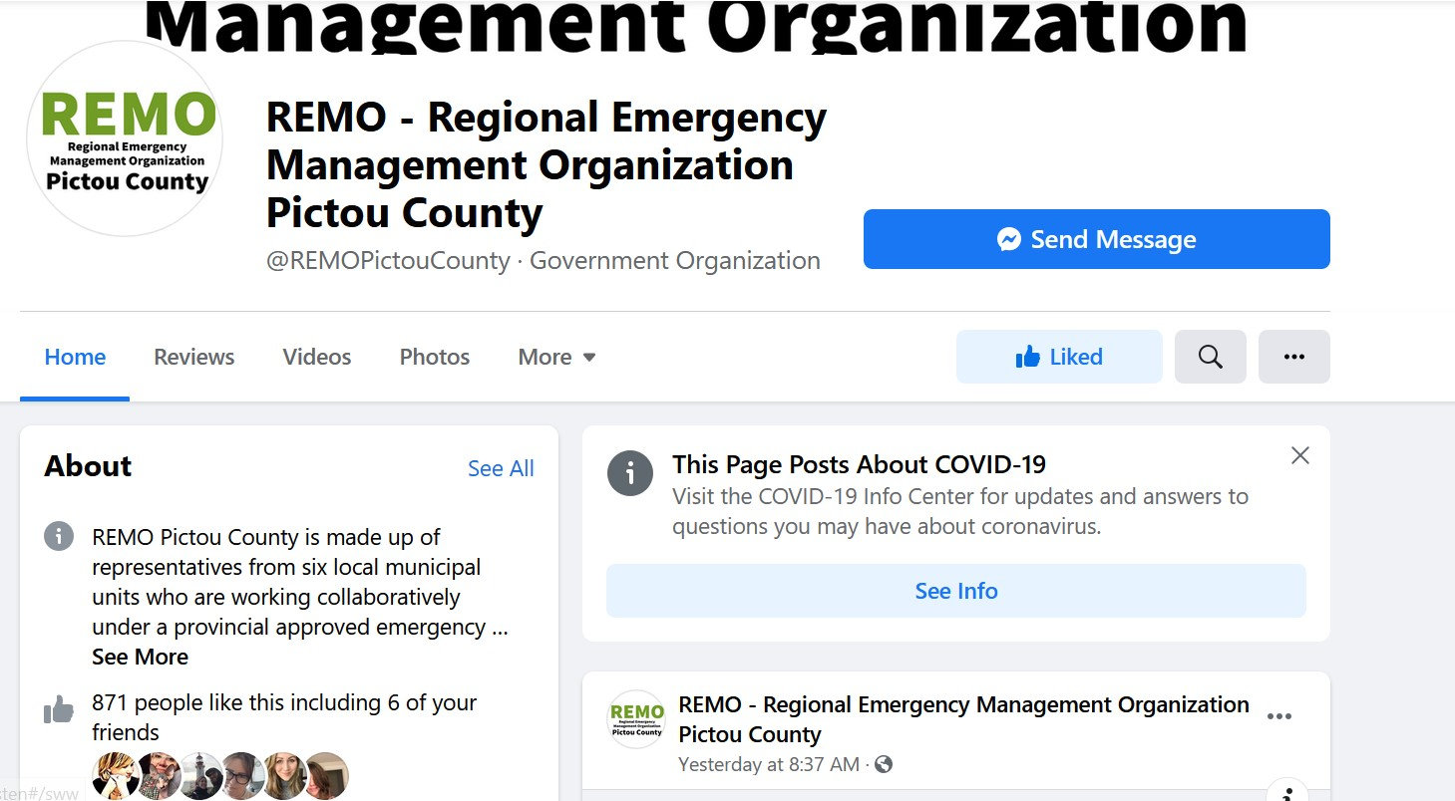
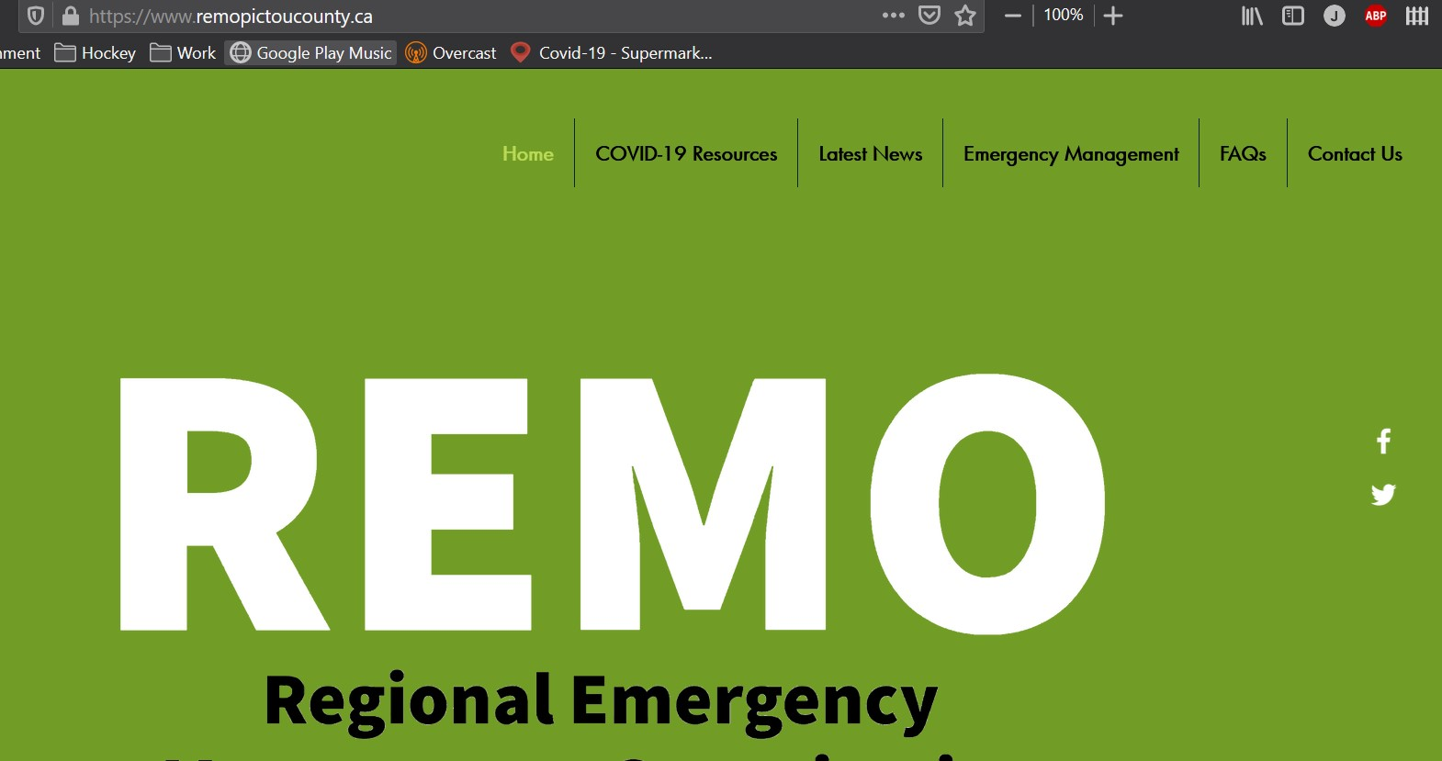
COVID-19 Response
Expanded Public Information Committee
New Glasgow, Stellarton, and the Municipality of Pictou County all provided staff resources
Twitter, Facebook, Website
Newsletter
Videos

Slide 17

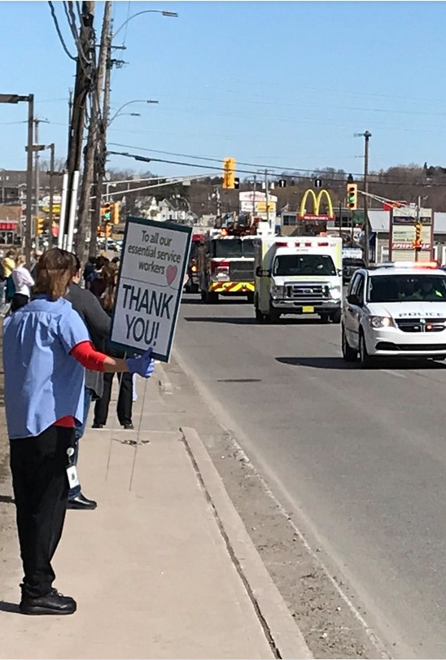

COVID-19 Response

Slide 18
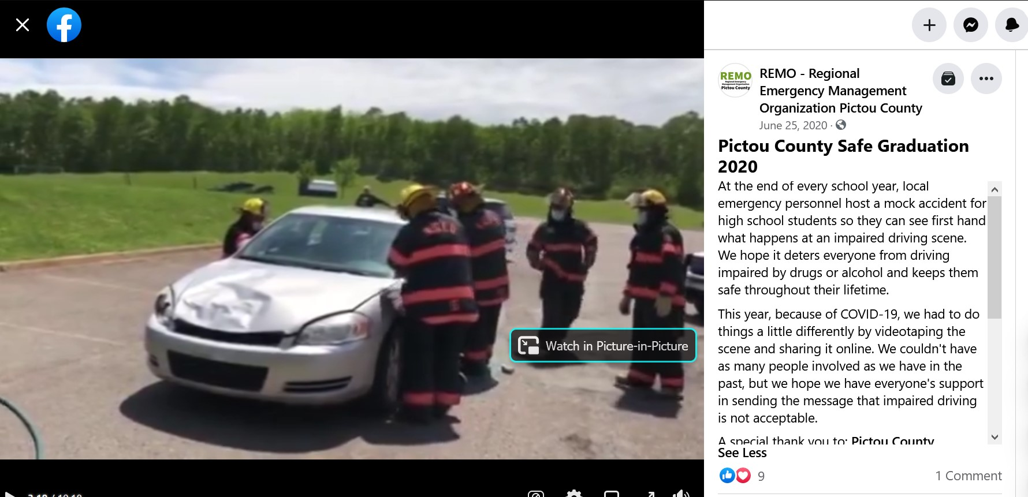
COVID-19 Response
Provided safety plan supports for community groups hosting fundraisers over the summer
Worked with recreation departments & Department of Communities, Culture and Heritage to assist with rec re-openings
Produced SafeGrad video for COVID graduations

Slide 19
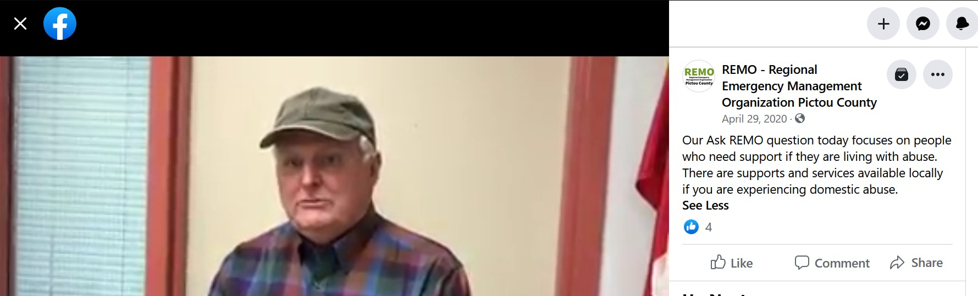
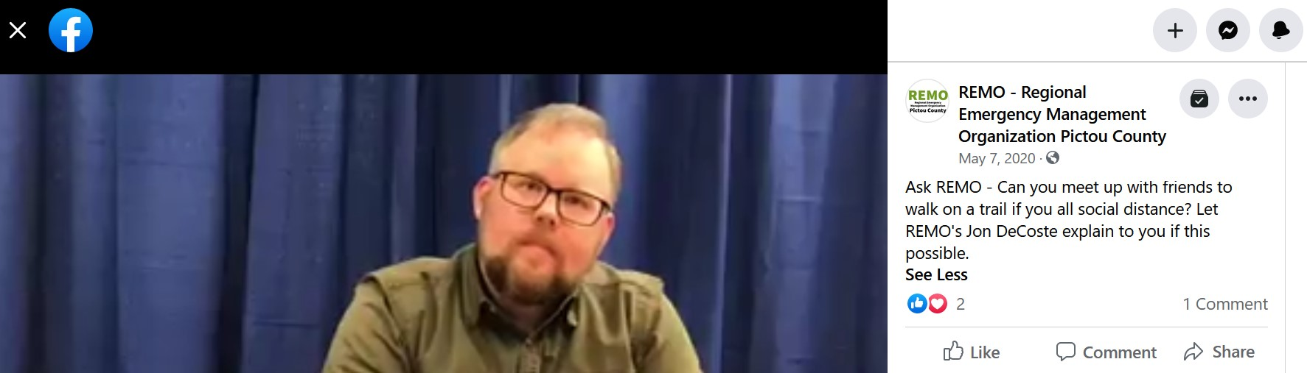
COVID-19 Response

Slide 20
COVID-19 Response
Conducted After Action Review in October 2020
Incorporated lessons learned into planning for Wave 2
Activated again for Wave 3, work continues!

