Slide 1




The Mentoring Plus Strategy
Presentation to The Nova Scotia Federation of Municipalities Spring Conference
May 6th, 2021
Dalhousie University - Faculty of Open Learning and Career Development provides support and guidance
as the Backbone Organization for the Mentoring Plus Strategy.
Funded by the Government of Canada’s New Horizons for Seniors Program

Slide 2

Issues Facing Atlantic Canada
An increasing number of retirees.
Increased health costs.
A growing number of businesses looking for new owners.
A reduced labour force.
The need to broaden our workforce from many populations.
Organizations need to find ways to transfer knowledge from retired employees to the next generation.
APEC Looking Ahead Bulletin 2 January 2021

Slide 3
Future of Work
Demographic Change
Educational Attainment
Economic Transformation

Slide 4

Demographic Change

Slide 5
Profile of Seniors in Canada
Seniors in Canada are a rapidly growing segment of the population and are living longer and healthier lives than previous generations.
Seniors who are active and engaged in the labour force and their communities contribute to the economy and society, as well as to their own health and well-being.
The wealth of seniors' knowledge, experience and skills can be translated into meaningful involvement in their communities.
Government of Canada — Action for Seniors Report

Slide 6
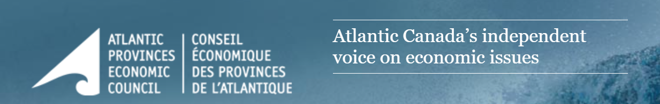
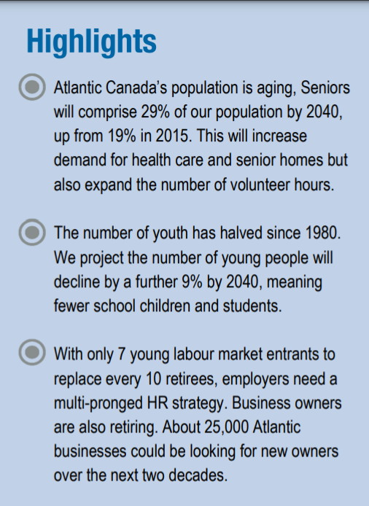
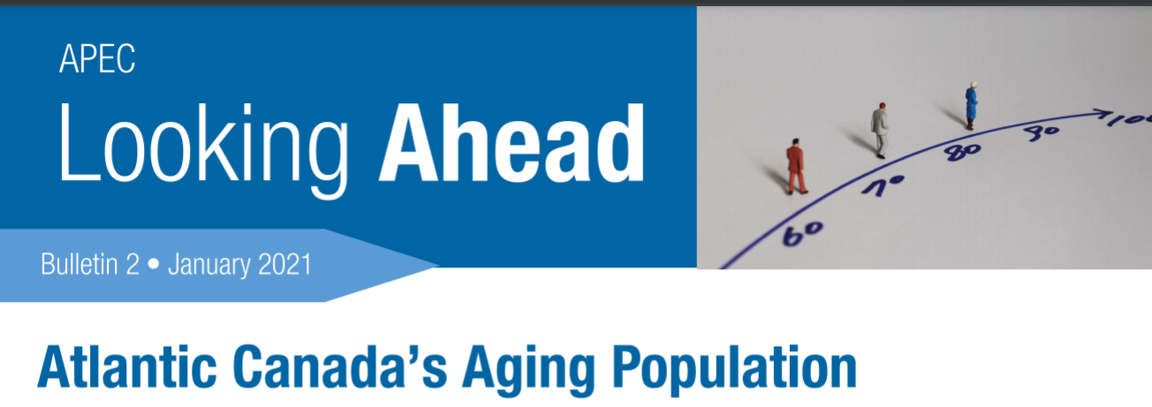

Slide 7
Statistics Canada. Table 17-10-0139-01 Population estimates, July 1, by census division, 2016 boundaries

Slide 8

Economic Transformation

Slide 11

Educational Attainment

Slide 12
Our Challenge
26.5% of high school grads don’t meet post-secondary admissions requirements. School to Work Transition Report 2017
32% of NSCC students in diploma/multi-year programs do not return after the first year. School to Work Transition Report 2017
17% of Maritime students are no longer enrolled in a Maritime university after their 1st year. MPHEC Oct 2019 – Persistence & Graduation
42% of students complete their degree in 4 years (19% in 5 years) Maritime Provinces Higher Education Commission – 2019 Persistence & Graduation Report
100,000+ Nova Scotians are on some form of assistance School to Work Transition Report 2017

Slide 13
Overview

Slide 14
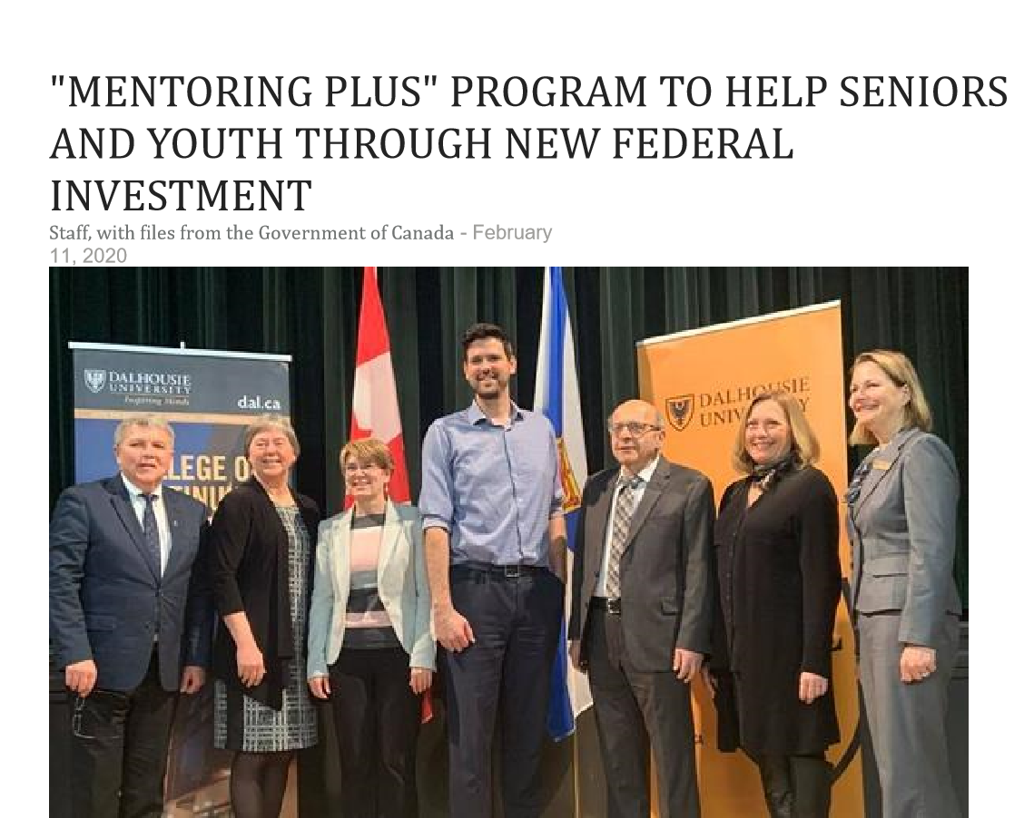
Left to right: Bill Mills, Mayor of Truro; the Honourable Deb Schulte, Minister of Seniors; Dr. Dianne Tyers, Dean CCE; Sean Fraser, MP Central Nova; Gordon Michael, Executive Director of Mentoring Plus; Nancy Dicks, Mayor of New Glasgow; and Sandra Snow, Mayor of Kentville. (Provided photo)

Slide 15
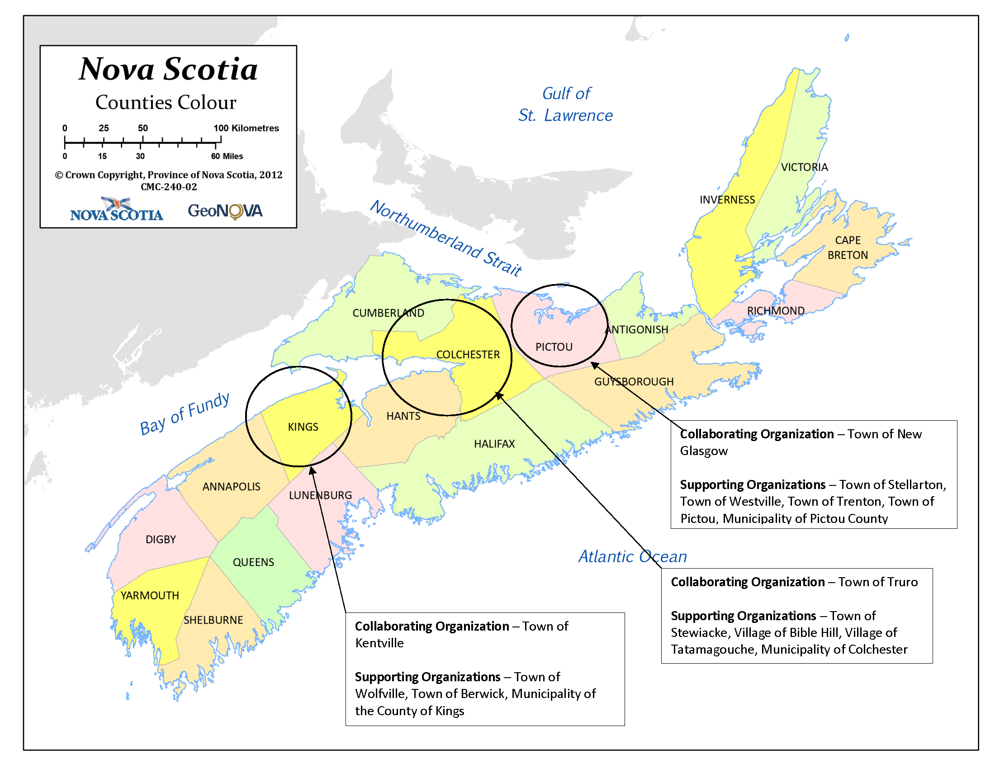

Slide 16
Seniors will be able to share their skills and knowledge about their careers and life experiences, while contributing to the life of the community.
Uses an intergenerational approach that contributes to social inclusion of seniors and supports knowledge exchange approaches.
The Mentoring Plus Strategy
Aims to draw upon the skills and knowledge of retired/near retired people to help support high schools, community college and university students along with individuals involved in employment related services. The goal is to explore and connect to career paths by implementing a variety of initiatives and activities.

Slide 17
The Mentoring Plus Strategy is pursuing approaches to address diversity and inclusion with a number of minority populations including the African Nova Scotia community, Indigenous community, Immigrant populations and other minority groups.
A Mentoring Plus community outreach position for the African Nova Scotia community, located in Truro, is working with high schools and other members of the African Nova Scotia community to explore a variety of career opportunities.
A facilitator from the African Nova Scotia community is exploring strategies that will address diversity and inclusion.
The Mentoring Plus Strategy
Diversity and Inclusion

Slide 18
Knowledge Exchange
Mentors
Mentees
Organizations
Educational Institutions
Agencies

Slide 19
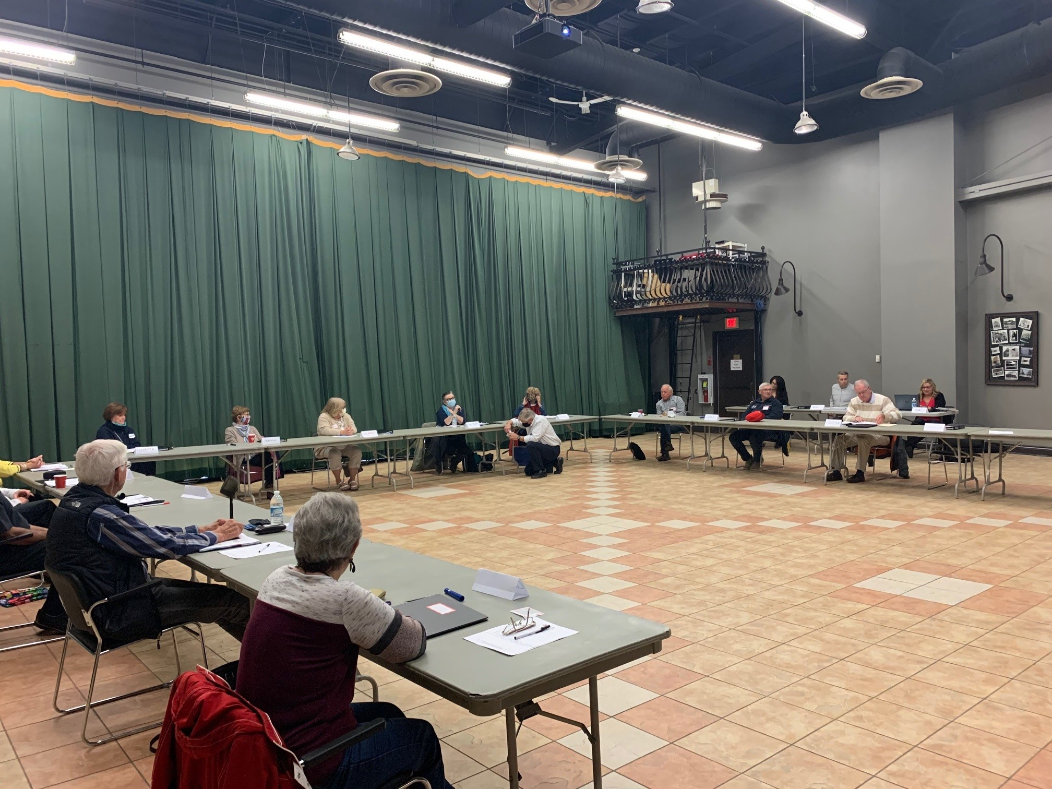
In Person and Virtual Mentor Orientations
Mentors
Ongoing workshops on identified topics
Identifying mentors

Slide 20
Organizations
Educational Institutions
Agencies
The Business Community
High Schools
Nova Scotia Community College
Universities
Employment Related Agencies
(unemployed & underemployed)
Mentees

Slide 21
5 Stages of Mentoring Plus Knowledge Exchange
Exploring the Future of Work
Focusing on Career Path
Experiential Learning/Work
Further Learning Opportunities
Towards a Sustainable Livelihood
(Connecting to Employment Trends and Labour Market Research)

Slide 22
Some of our Initiatives

Slide 23
Business

Slide 24
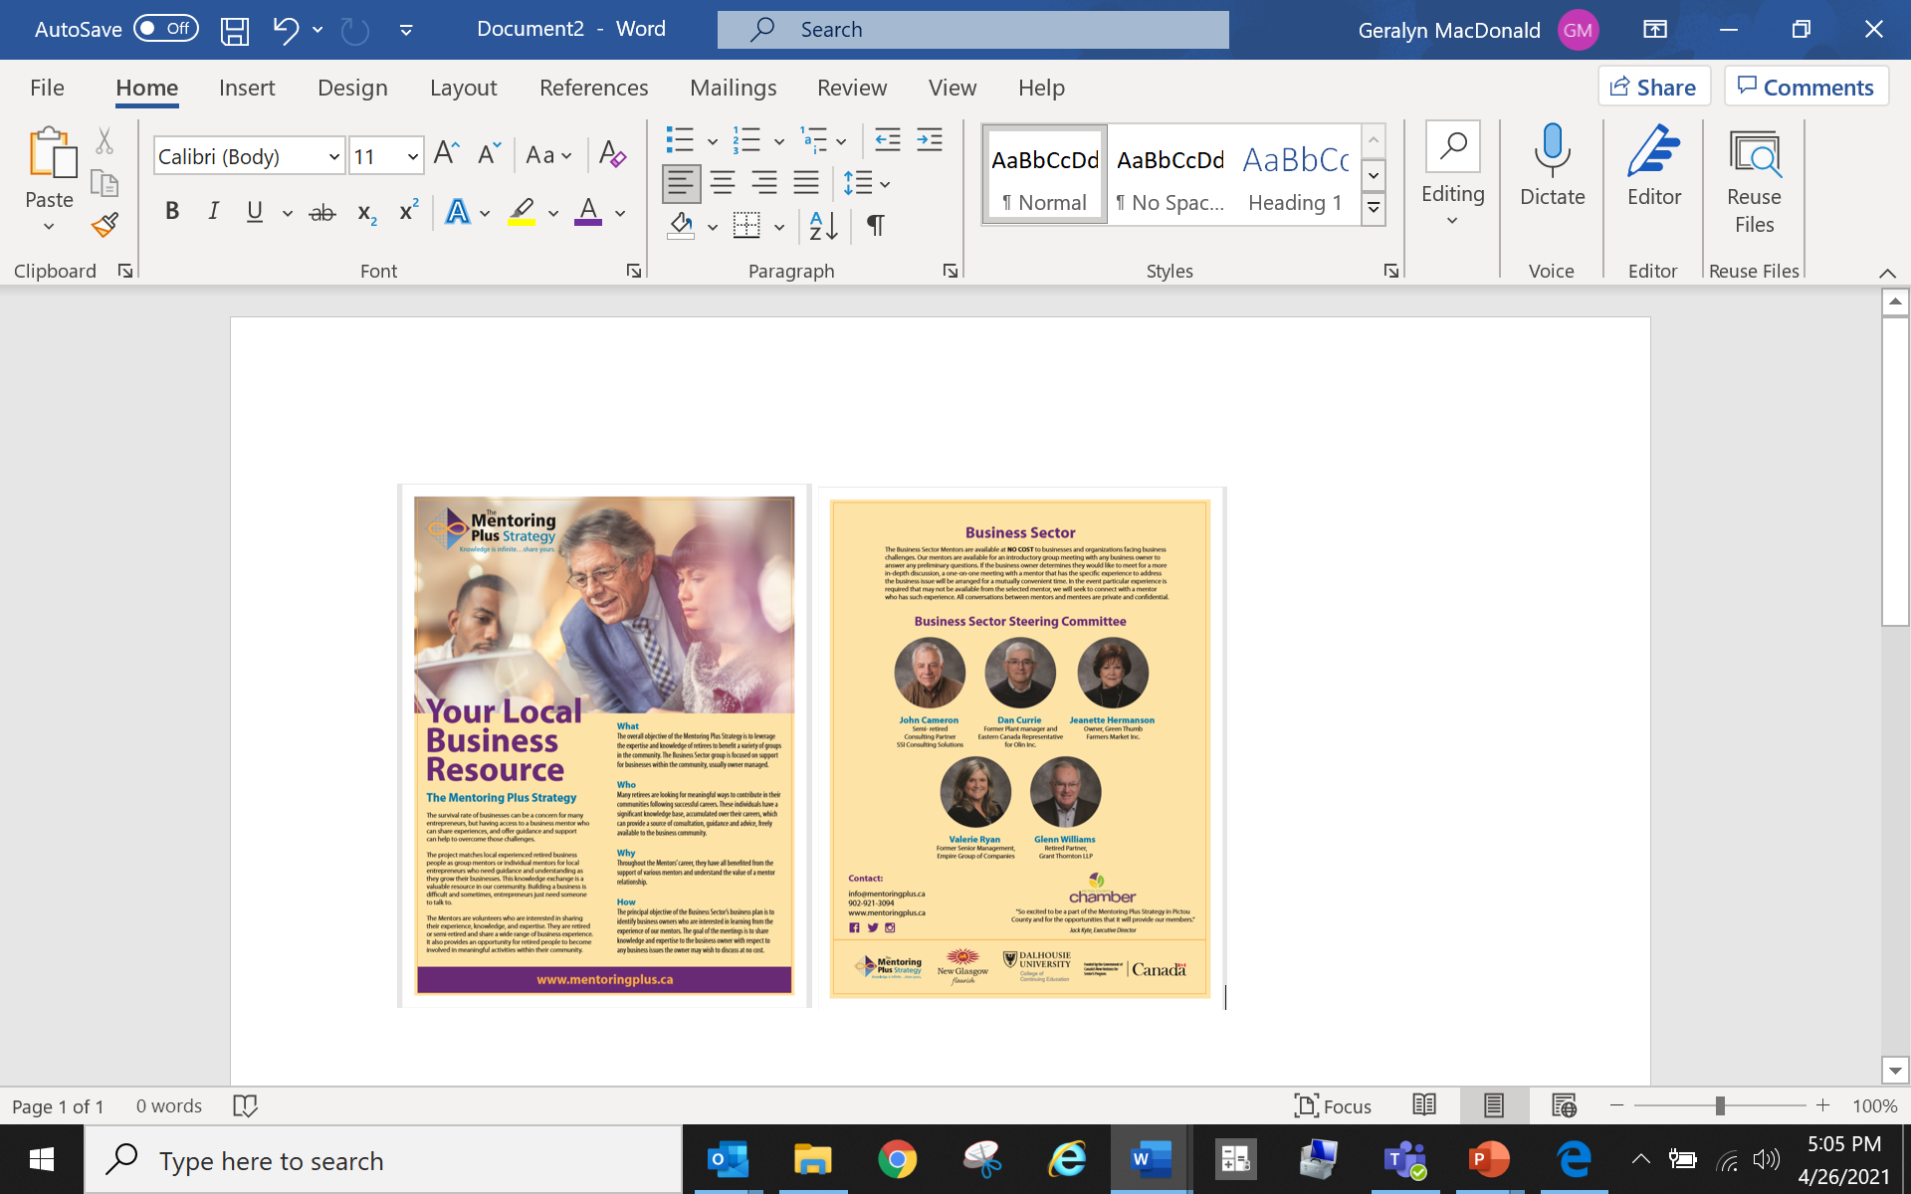

Slide 25
Health

Slide 26
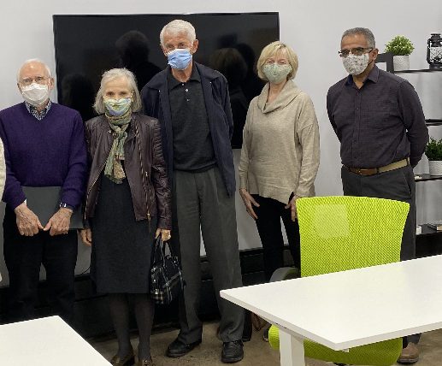
An engagement session was held with retired health professionals and other partners from New Glasgow, Truro and Kentville.
Over 30 career paths were identified in the health sector.
Local work includes the formation of a Health & Wellness Sector Steering Committee and Action Plan.
New Glasgow, Truro and Kentville working with local mentors and health navigators in supporting students/employees currently in the health field.

Slide 27
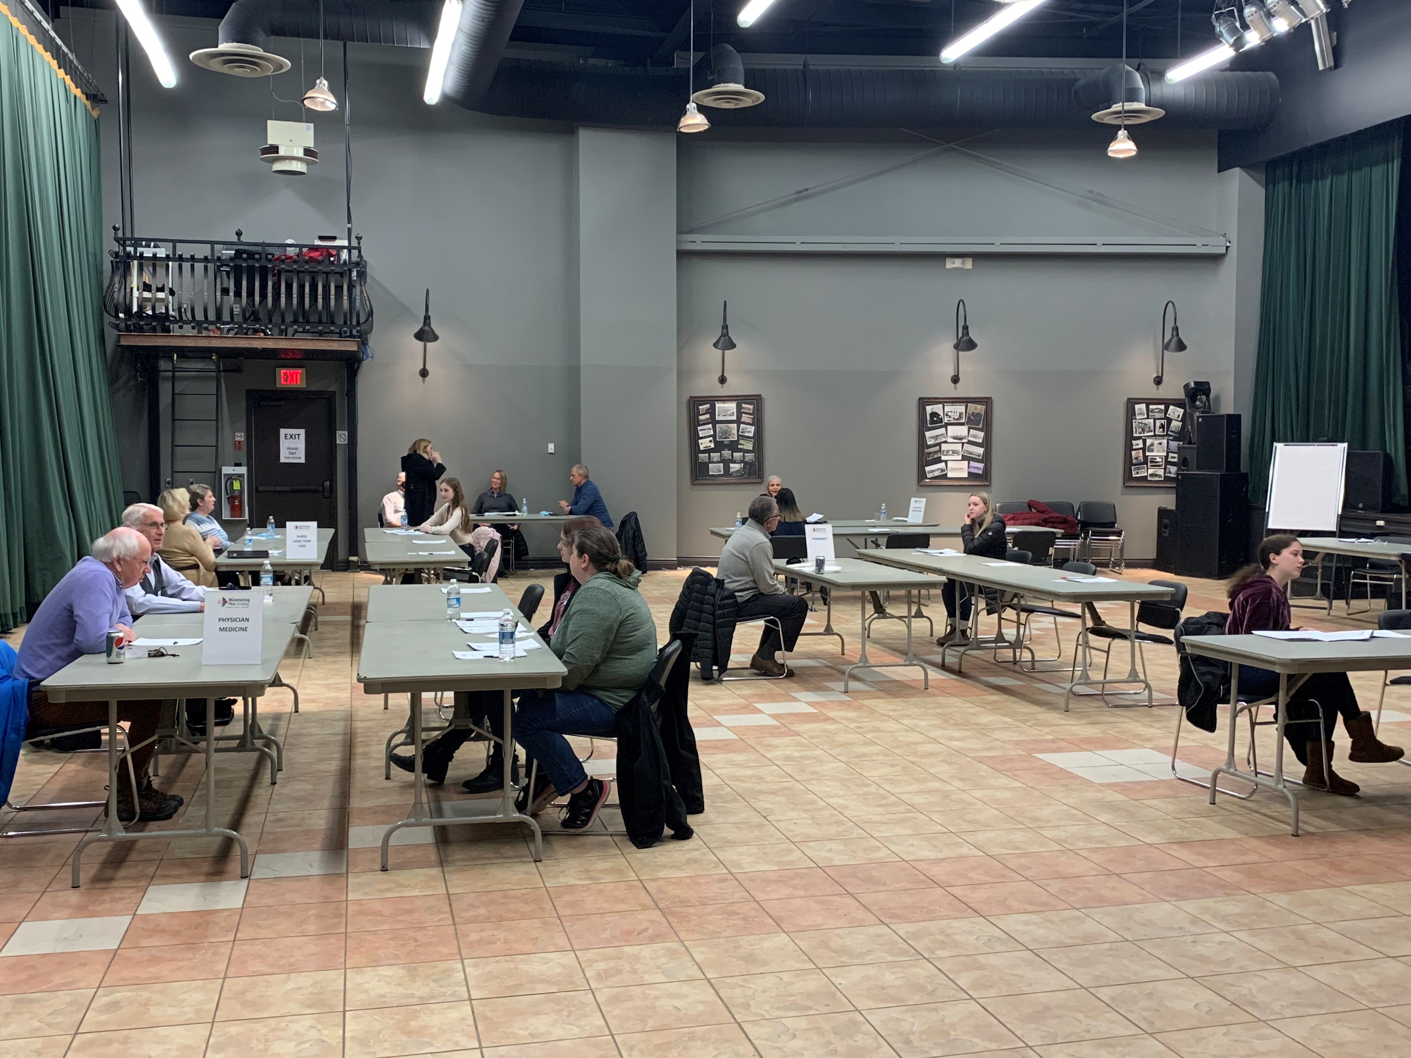
An example of knowledge exchange with high school students on the health sector.

Slide 28
Trades

Slide 29
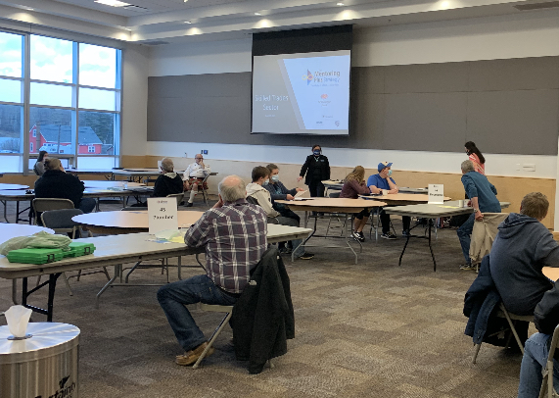
An Example of a Trades Mentoring Session
Mentoring Plus is working with provincial and local career pathways consultants, to discuss the opportunities to expose youth to skilled trades and see Mentoring Plus as a valuable resource.

Slide 30
Arts & Culture

Slide 31
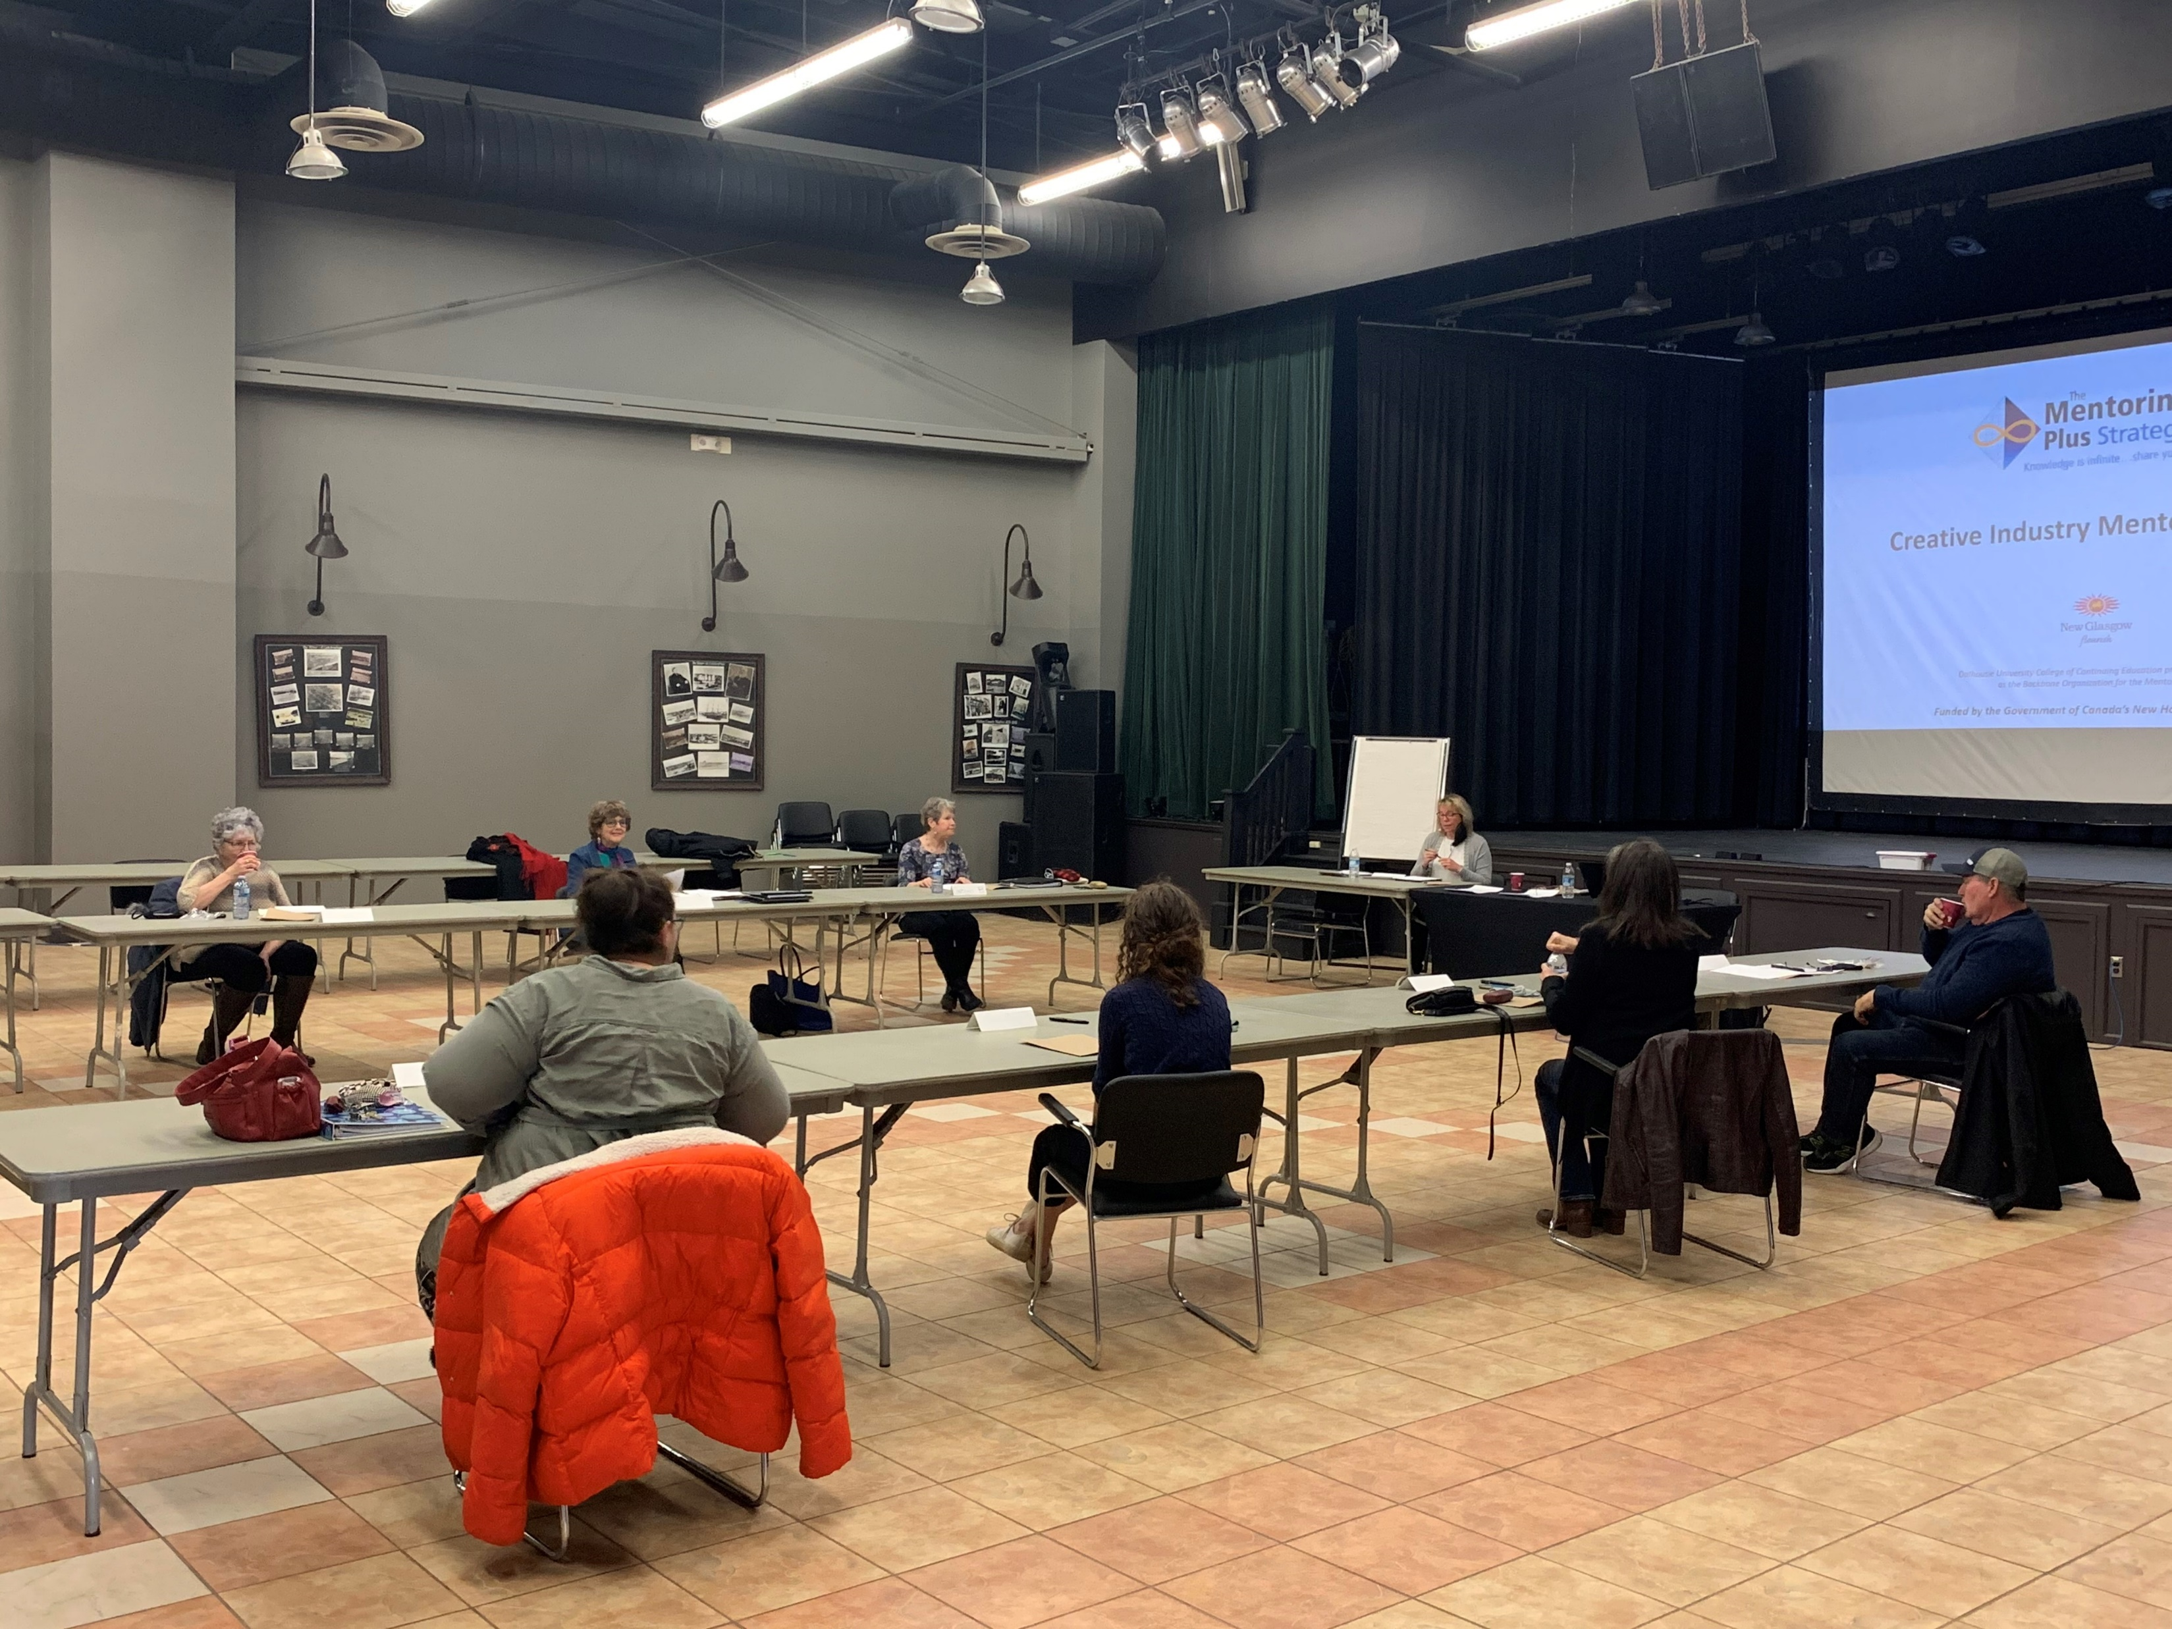
An Arts & Culture Session
Group mentoring on topics such as finding confidence, discipline, voice, and understanding entrepreneurship in the creative industry.

Slide 32
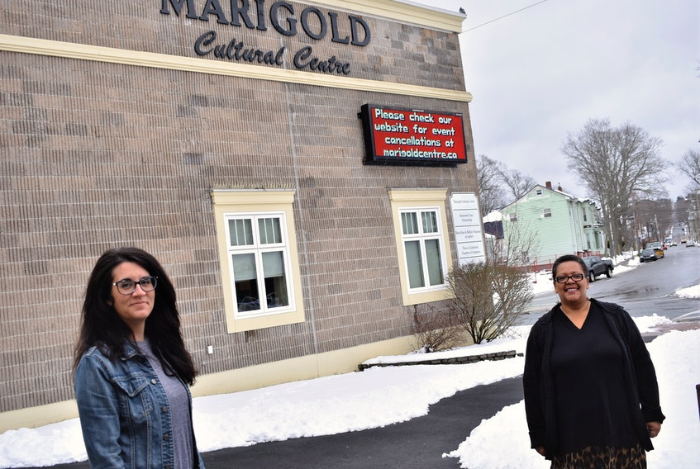

The Truro Mentoring Plus team moved into the Marigold Cultural Centre in January 2021. The Marigold is a hub of arts and culture, arts education and venue for performing arts. With many seniors already taking part in volunteering, art and music classes etc., it’s a great partnership space.

Slide 33

Free Computer Training for Seniors
Topics Include:
Internet safety, Social Media, Video Calling and Google Apps.

Slide 34
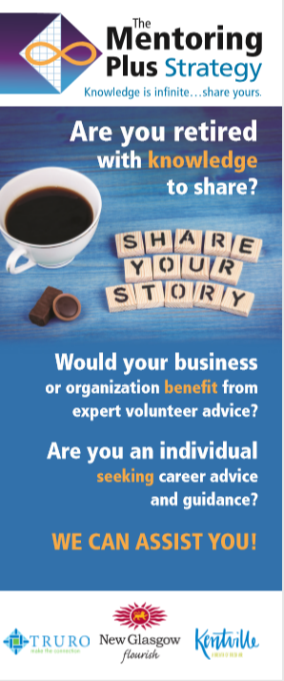
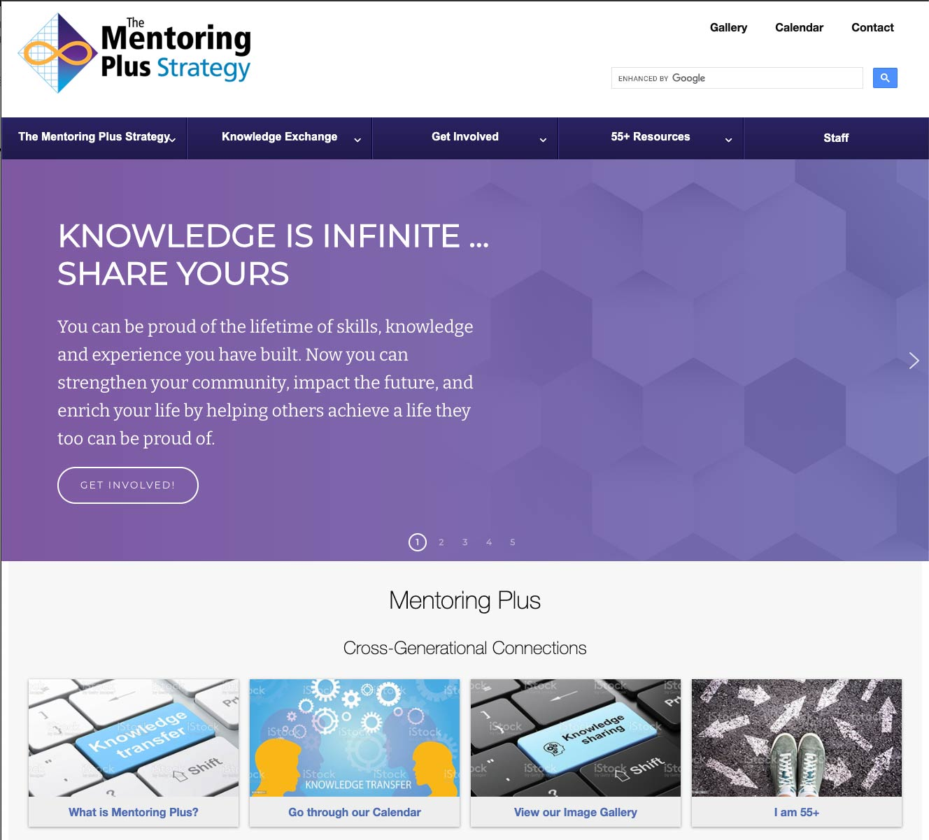
Program Brochure and Website
www.mentoringplus.ca

Slide 35
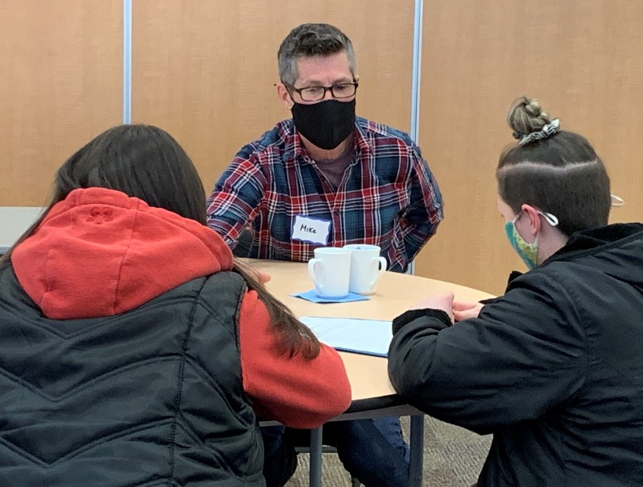
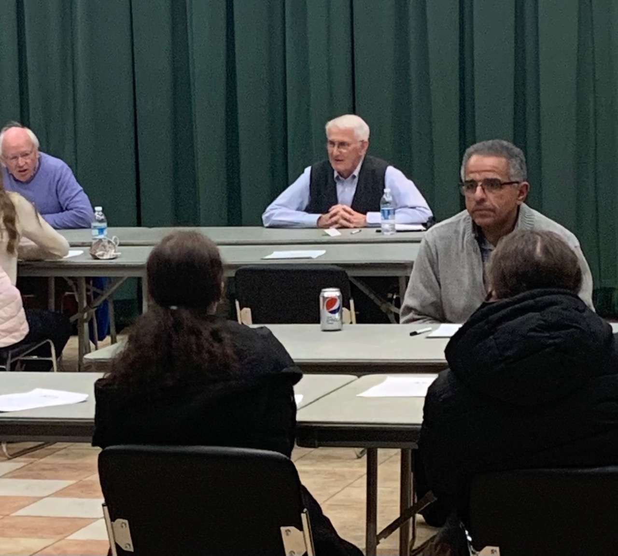
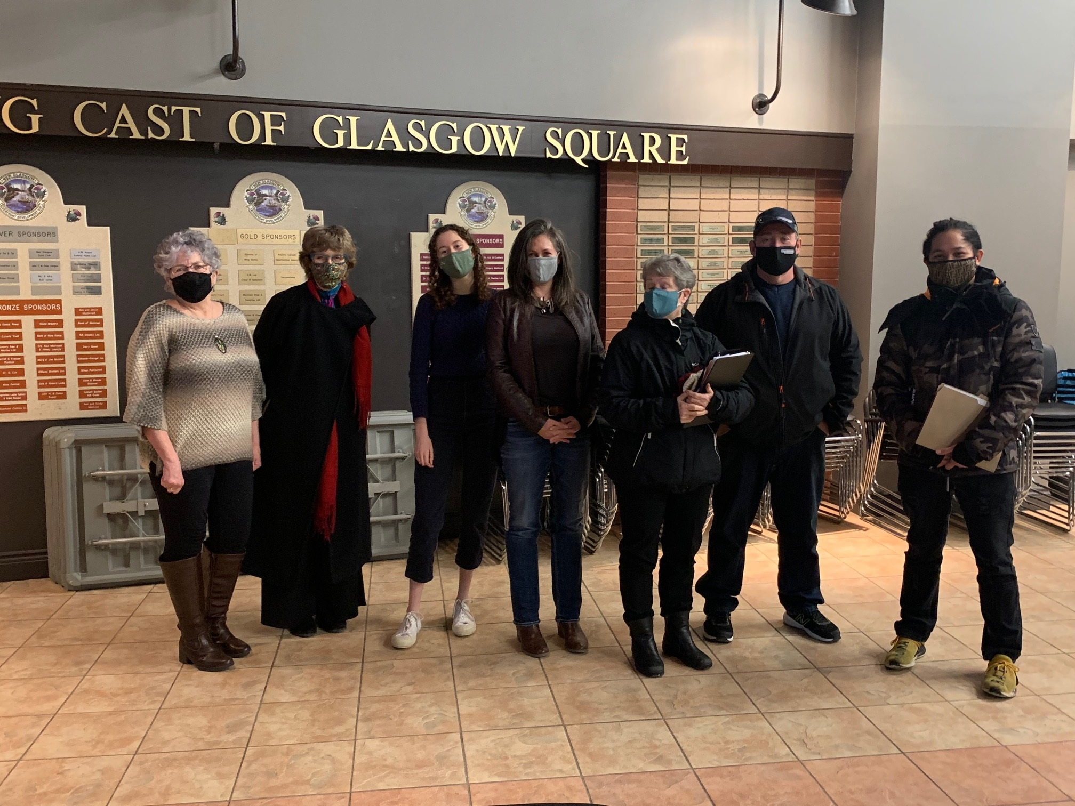
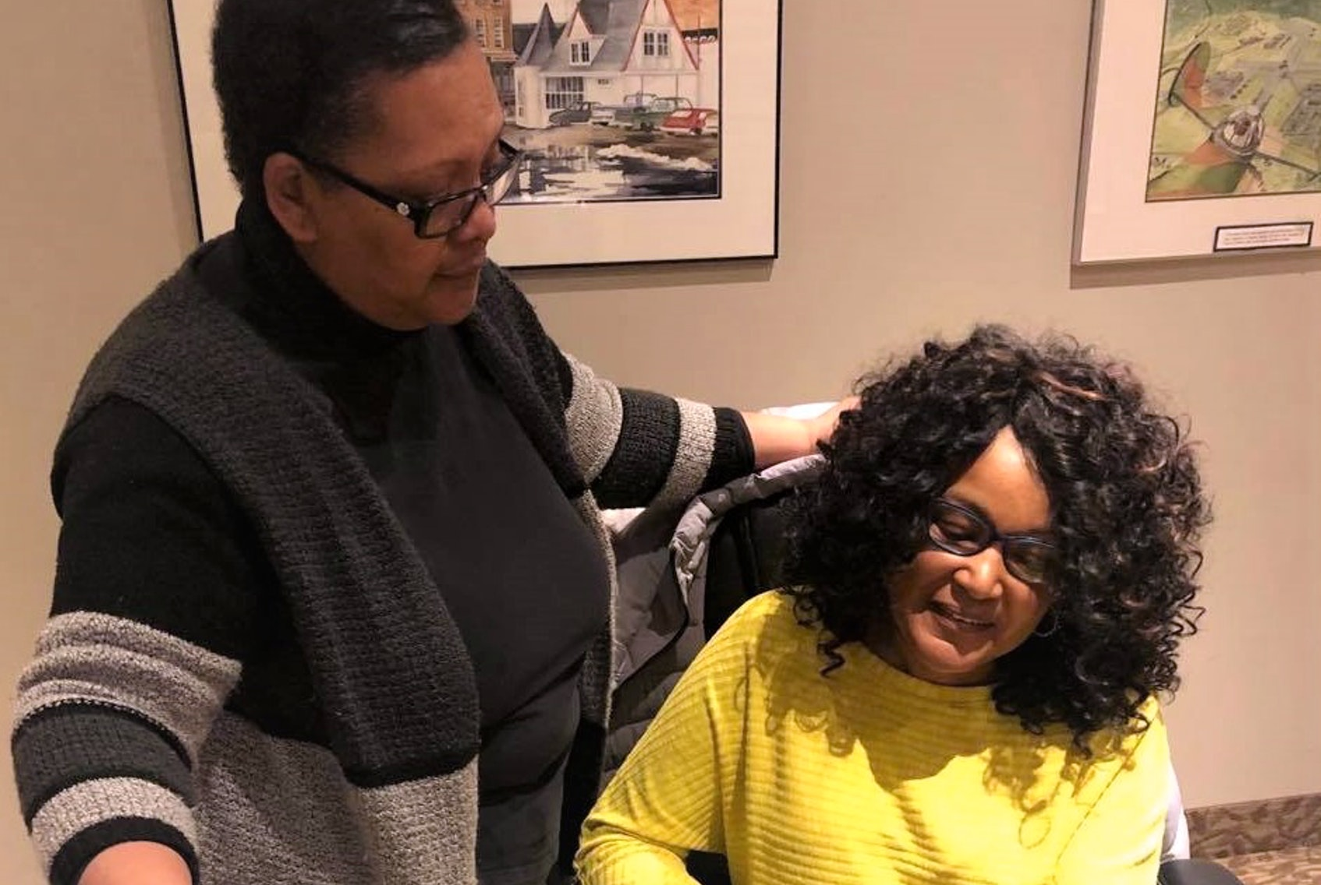
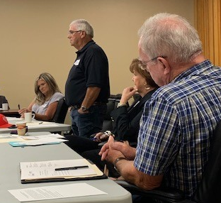
Group Mentoring
Knowledge Exchange

Slide 36
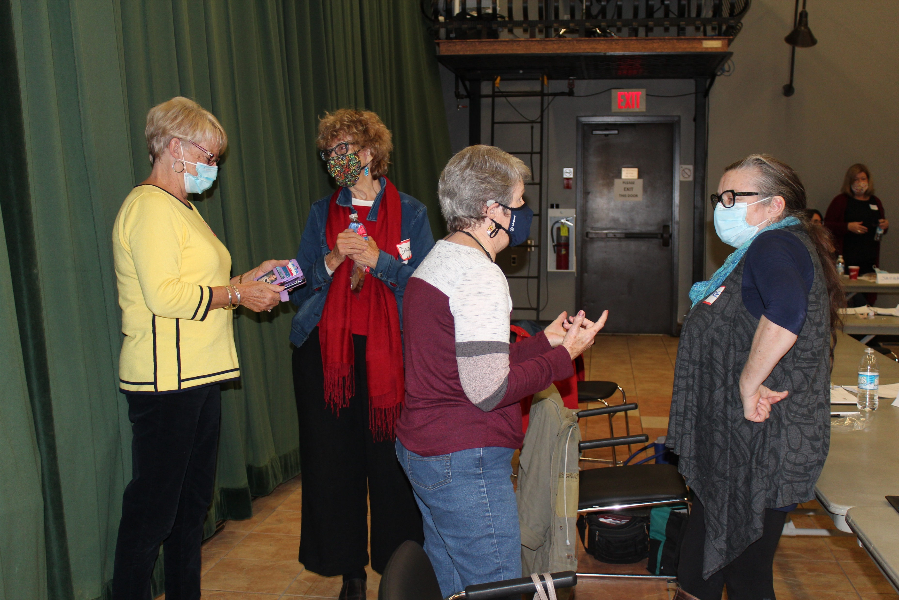
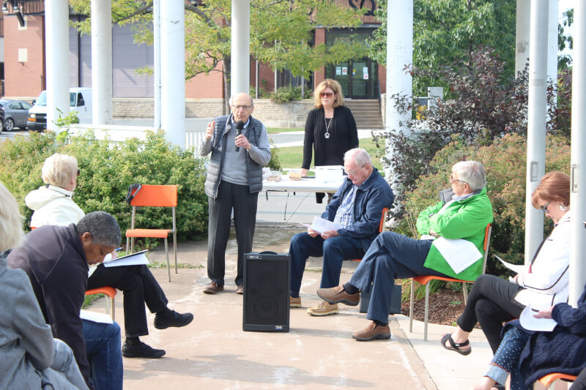
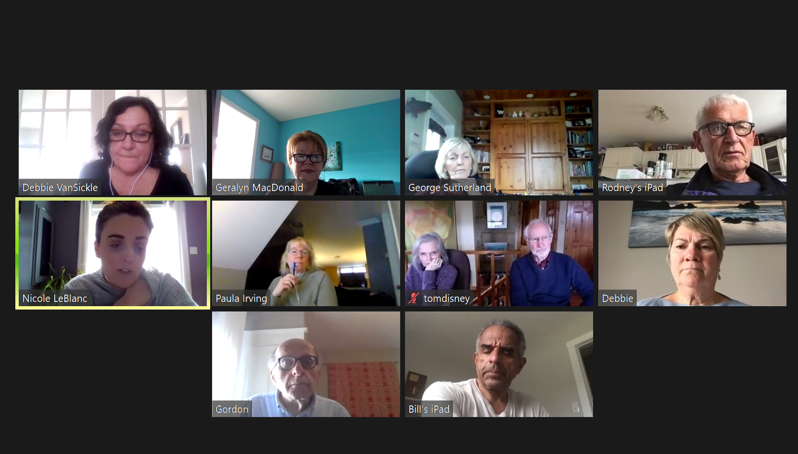
Group Mentoring & Knowledge Exchange Pandemic Style

Slide 37

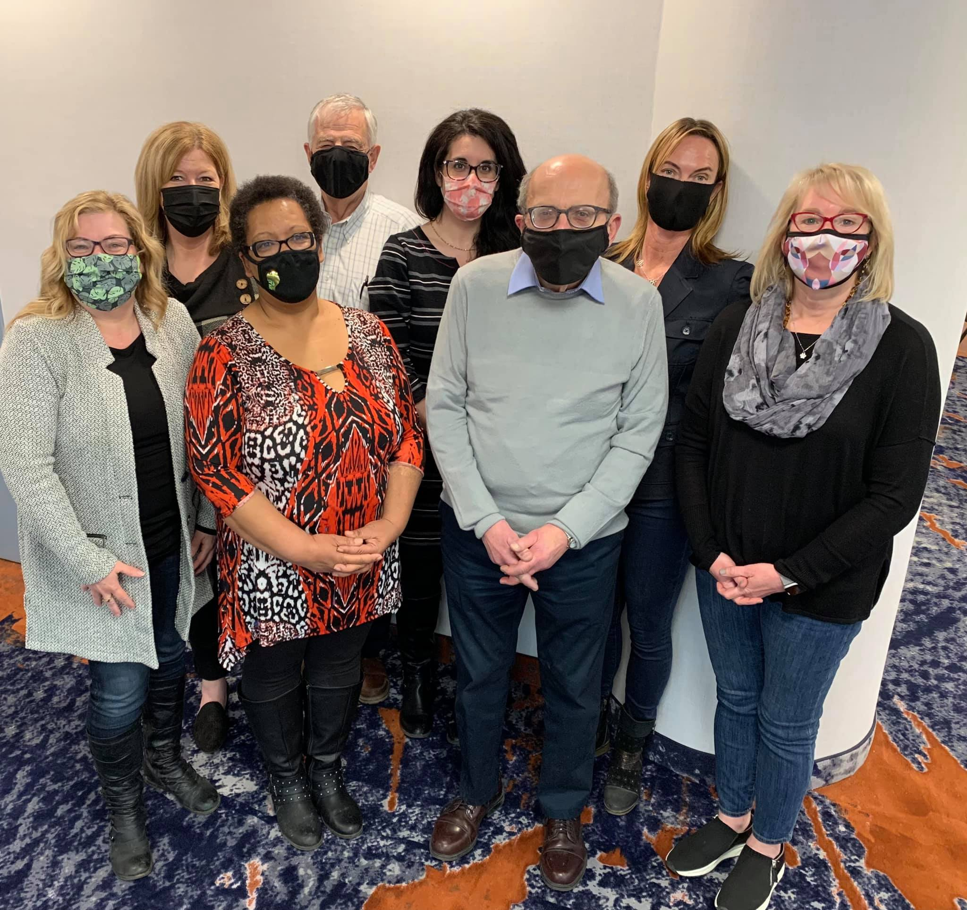
The Mentoring Plus Team

Slide 38
The Collaborating Municipalities - New Glasgow, Truro and Kentville - are integral to the success of the Mentoring Plus Strategy.
“In Truro there had been concerns voiced by seniors about loneliness, and how they could contribute to the community in a meaningful way. Mentoring to young people and sharing life experiences addresses all those issues! Perfectly!!”
Mayor Bill Mills
Truro
“The Mentoring Plus pilot project took place in New Glasgow and the success of this pilot created the opportunity to grow. It has now become an amazing program where retired people with a wide array of backgrounds are connecting with others in our community to share their experience and expertise. Watching the sessions in action speaks to its value... excitement, connection and purpose!”
Mayor Nancy Dicks
Town of New Glasgow
“Mentoring Plus is preparing our community for the future by bringing together and using the community’s most valuable asset, our people. It allows our retirees to continue as a valuable resource adding learned knowledge to help those who need the encouragement and support to lean into our future needs.”
Councillor Paula Huntley
Town of Kentville

Slide 39
For more information contact:
Gordon Michael,
Executive Director
1-902-580-4588
Gordon.Michael@dal.ca

Slide 40
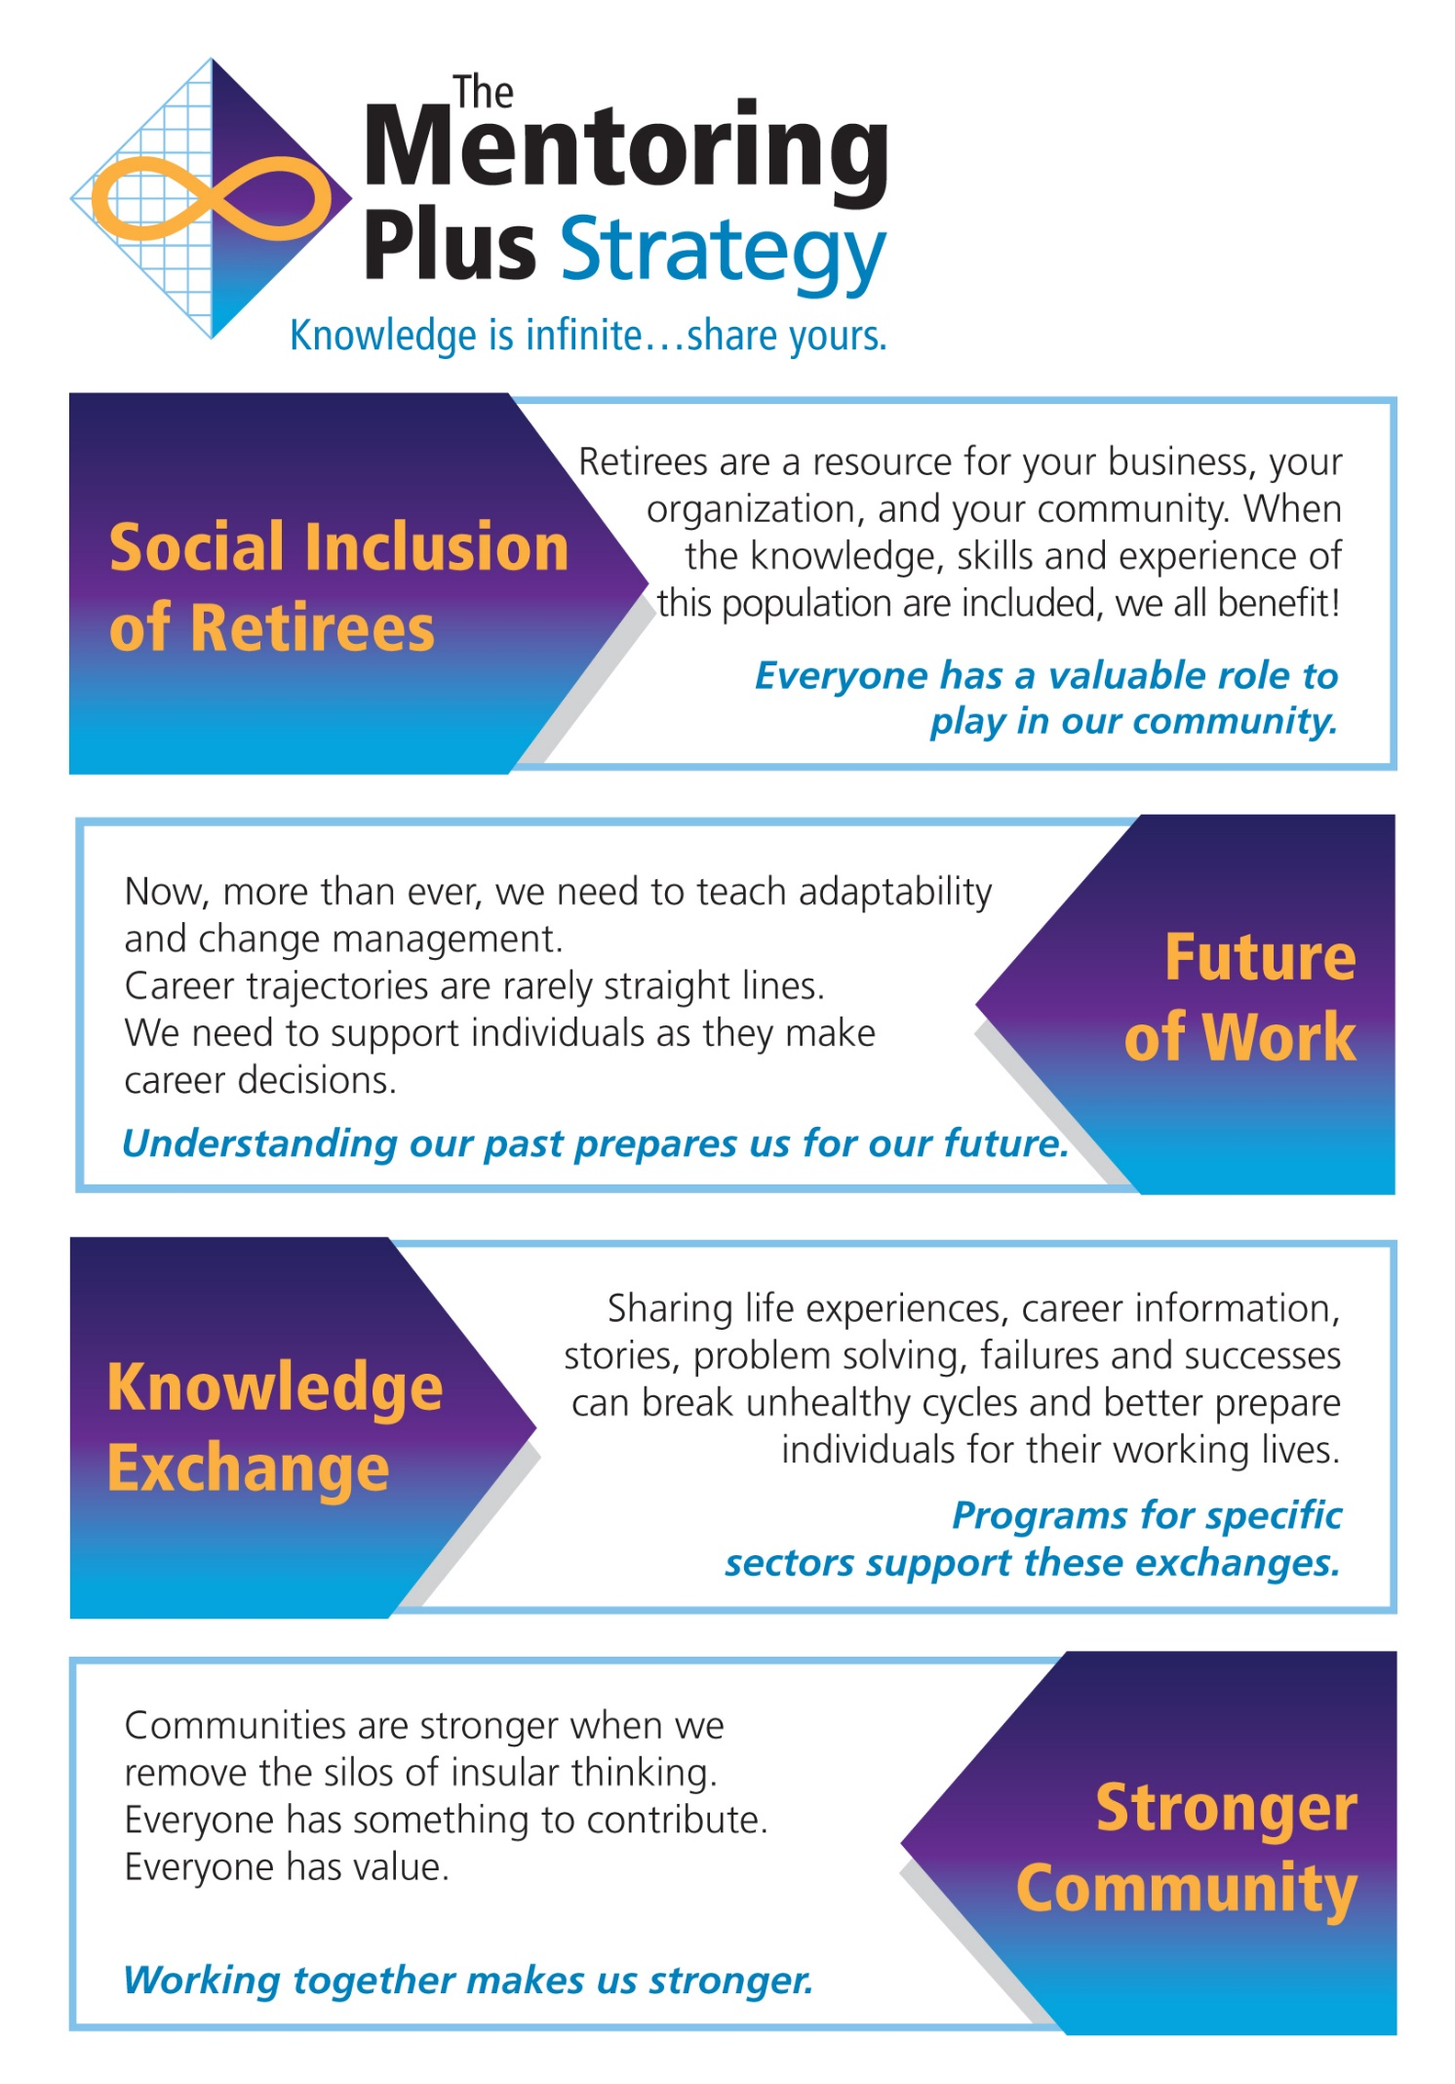
Thank You!
Questions?

